Slide 1

Communication and Alternative Coms
Land Line to over the air, and why we need more than one type to communicate in various situations

Slide 2
Frequency and Impact, and communication choices
Frequency and Impact
Communication Choices
Low Impact, High Likelihood Situations
  Job Loss, less than 8-Hours No Power…
Medium Impact, Medium Likelihood Situation
  Small Area Evacuation, Low to Moderate Earthquake, 8 to 24-Hour without Power….
High Impact, Low likelihood Situations
  Major Earthquake, Multi-day power Outage, Large area Evacuation….
Land Line
Software Applications
Cell Phone
Walkie-Talkies
FRS Radios
Citizen Band (CB) Radios
GMRS Radios
HAM Radios

Slide 3

Communication Plans
Personal or Immediate Family
Extended Family
Neighborhood or Block
Ward
Stake
Notes:
Family: do children know what to do, who do you contact in or out of the area as the situation dictates. Are there backup contacts
Neighborhood: do you know your neighbors, and have alternate ways of communication
Ward: Can the Bishopric get communication to identify need and send assistance, do members fulfill their ministering assignments
Stake: Can the Stake Leadership contact the Wards Bishopric for communication of needs or members who can support service

Slide 4
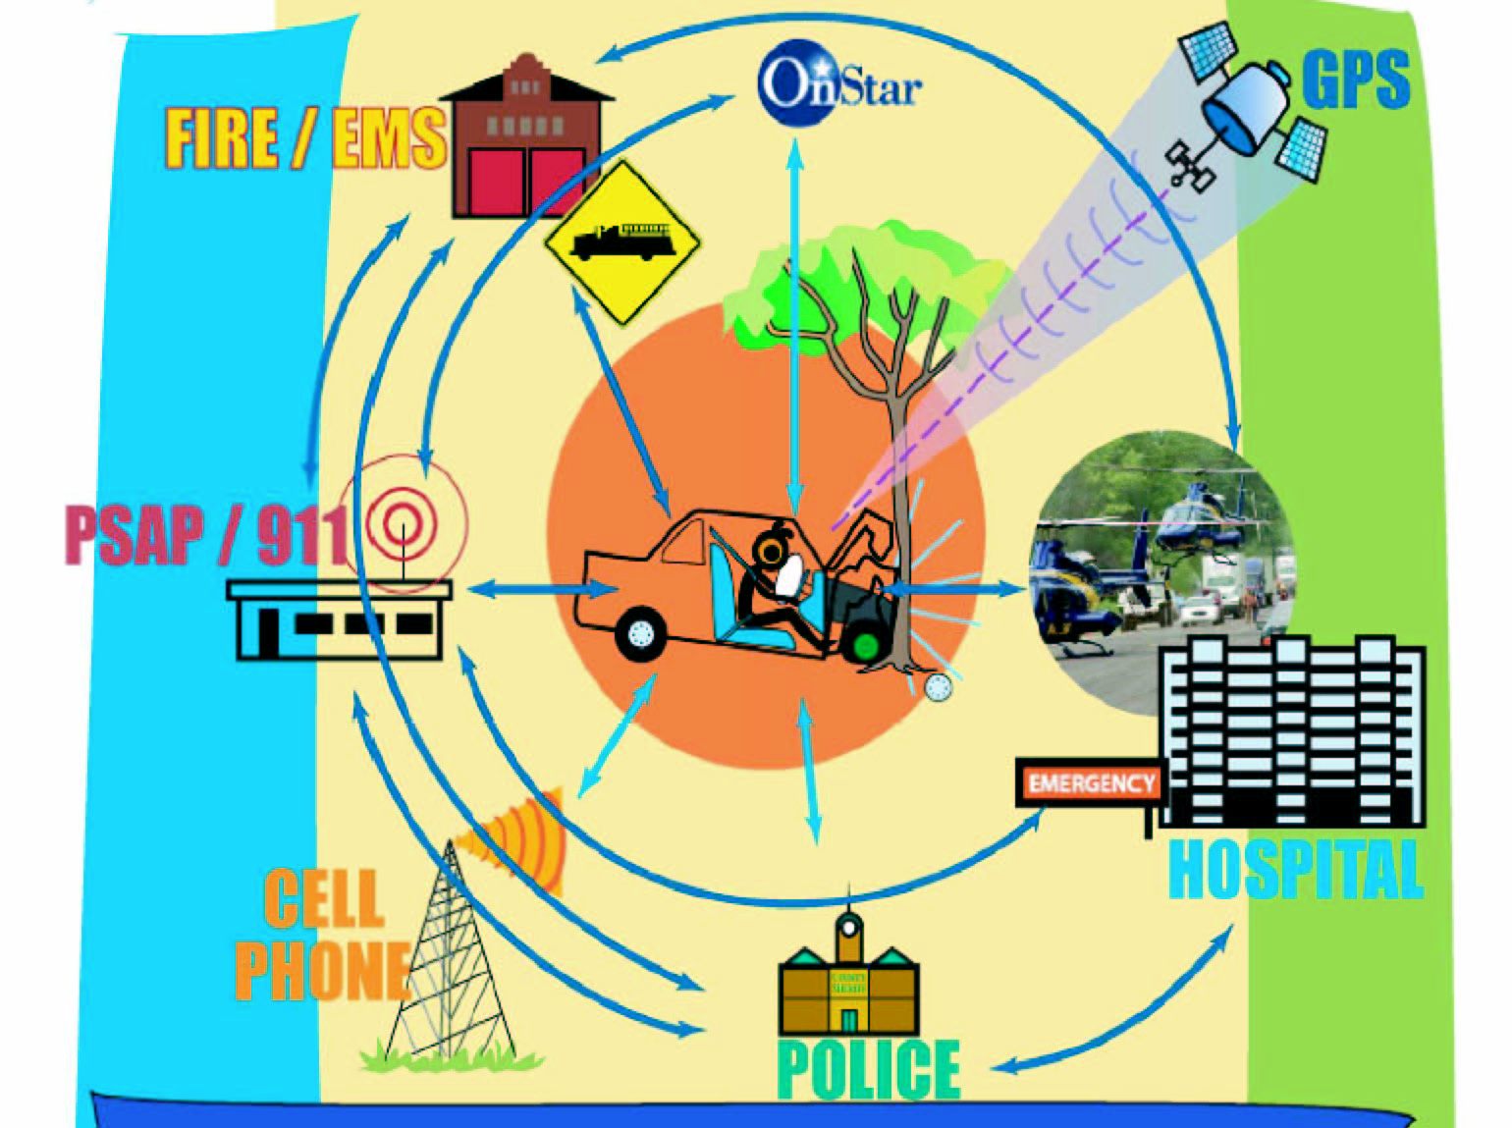
Emergency Situational Impact
First Responder Communication Priority Service
Communication System Overloaded
Power Loss
Communication System Damage

Slide 5
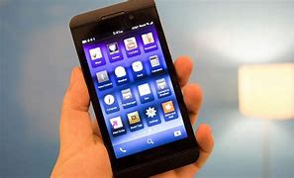
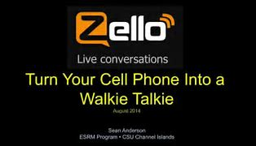
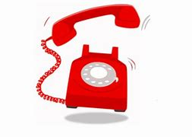
Communication Summary Sheets
Land Line Phone
Cell Phone
Zello Application
Cost: Monthly Fee (Starting at $10)
Great for Day-to-day communication and may work depending on the event and severity. System is not mobile, and does not have added services or features
Cost: Monthly Fee (Starting at $20)
Great for Day-to-day communication and may work depending on the event and severity. Can be use wherever service providers have communication towers and has access to text and other application software.
Cost: Free
Can be downloaded on cell phone, tablets, or computers. Person to person or group communication is possible. May not function without wired internet, wireless internet, or cellular service. Ward and Stake may already have dedicated channels or groups set up.

Slide 6
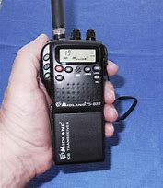
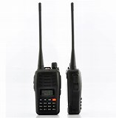
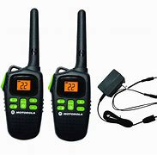
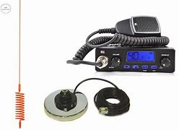
Communication Summary Sheets
Walkie Talkie
Citizen Band Radios (CB)
Family Radio Service (FRS)
Cost: $15 to $80 per unit
No privacy from others on use
Urban Range 200 yards or vertical about 5 floors in buildings to 2 miles in open area with no obstructions
Cost: Handheld $40 - $80 - Base Station $90 to $180 per unit
40 communication channels
Must have power source and no privacy from others on the same channel
Urban range of 0.5 to 1.5 miles depending on integrated or external antenna and power of system. Up to 25 mile in open area with no obstruction
Cost: $30 to $200 per unit
15 Channels with up to 42 privacy codes per channel
May have compatibility with GMRS systems on channels 1-15
Urban Range if ~0.5 mile and in open area with no obstructions 3–5-mile range

Slide 7
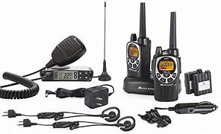
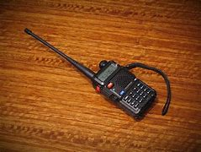
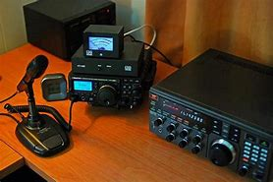
Communication Summary Sheets
General Mobile Radio Service (GMRS)
HAM Radio
Cost: $35 to $400+
Requires an FCC license (no testing required) at ~$80 and license covers the entire household for 10 years
Systems can be low power handheld to high power base systems, some sources require power sources other than batteries
22 channels (15 with the FRS) 8 repeater channels, with up to 142 privacy codes.
Range depends on wattage, antenna, and chosen operation channel, and if Repeaters are available. Urban range from 0.5 mile to 10 mile and in unobstructed areas up to 65-mile range.
Cost: $80 to $800+
Requires an FCC license and testing fees (starting at $15 and up) Three different License levels (Technician, General, Amateur). License is for an individual only and is good for 10 years.
Multiple frequency bands, ability to send digital data in some bands depending on equipment. Some equipment requires power sources other than batteries.
Range is dependent on wattage, antenna, repeaters, and chosen operation band (HF, UHF, VHF, etc.) some systems can communicate around the world, where other systems will only reach 10 miles in very dense urban terrain.

Slide 8

Current Stake Plan on Communication
Phone
Internet (email, social media)
Mass Text Message
Radio
  FRS/GMRS
    Was Channel 14, privacy 14
    To Channel 7, privacy 7
  HAM Radio
    Repeater at 147.21MHz
    Backup at 147.15MHz
Personal Contact
  Foot/Bicycle/Car/ATV. Etc.

Slide 9

Notes:
What are ideas that your Ward has together? Have those system been exercised to see if they will be operational and functional? Are there gaps, and are there workarounds to cover those gaps?

Slide 10

Detailed Communication Methods Information
Information beyond the basics

Slide 11
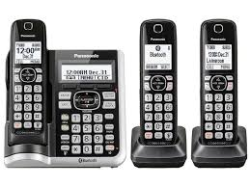
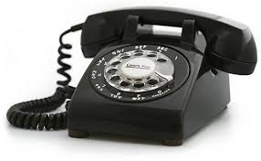
Land Line Phones
Requires Hardwire Connection
May operate without Power
Applications allow identification and near exact location of caller
Notes:
Pros: Infrastructure is stable it is very reliable form of communication, and may function during power outages, near exact location to First responder personnel, worldwide communication
Cons: is a static communication medium, and typically cannot be moved or used on the move

Slide 12
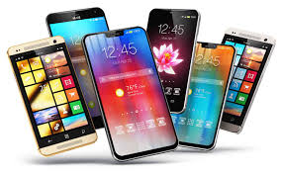
Cell Phones
Requires Tower or other wireless data connection
Towers can be overloaded in Emergency Situation
Text and email data options
Call 911 without a plan
Most are Waterproof
Batteries will need to be re-charged
Notes:
Pros: Mobile, can potentially be used during power outages as long as the cell towers are powered, depending on the area emergency responders may have accuracy within 150ft radius, multiple applications, text, and social media access, world wide communication
Cons: Requires a transposing repeater or other interface device to communicate to other phone connections, coverage in ~85% of the US, cell towers can only support so may devices communicating at a time in an emergency situation

Slide 13

Software Applications
Requires Computer or Phone Device
Requires power locally and to the network
Requires wired or wireless data connection
Application may require pre-set up for use, and acceptance into group chat modes
Applications
  HeyTell
  Two Way
  Voxer
  Zello
  Carrier PPT
Notes:
Pros: can be on a phone, tablet, computer, or other various applications
Cons: requires power and data interface connection (Wired, wireless (WiFi, or Cellular) may not function without power

Slide 14
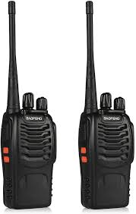
Walkie-Talkie
Pros
  No Grid required
  Direct immediate communication
  Common Battery size
  Reasonable priced
  No License
Cons
  Ideal range is by Line of Site (LOS)
  Moderate to heavy terrain will greatly reduce operating range
  Single channel operation, no privacy
Notes:
Handheld, young child communication fun.

Slide 15
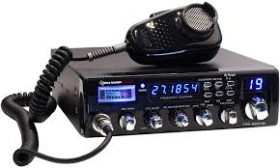
Citizen Band (CB) Radios
12 V Power Connection required
No Age Restriction for use
40 channels including weather, traffic alerts, and an emergency channel
Can adjust the sound, signal , and audio quality
Limited range to > 5 miles open line of sight down to <1 mile in dense urban settings.
Notes:
Short to mid range communication, typically 12V vehicle or battery powered devices, parties do not necessarily need line of sight for communication.
Pros: not many people use CB compared to 30 to 60 years ago due to competing technology (FRS, GMRS, Cellular), device to device communication, no tower or repeater required.
Cons: no privacy on any channels, limit of 37 out of the 40 for area communication, semi-portable, typically best in vehicle

Slide 16
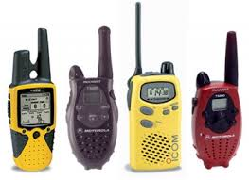
Family Radio Service (FRS)
Multiple Channel
Multiple Privacy channels
0.5 W on channels 8-14 and 2W on channels 1-7 and 15-22
Limited range typically from 0.3 to 1 mile depending on terrain
Can only have permanently attached antennas
Overlapping band usage with GMRS systems and some FRS and GMRS radios can communicate on common channels and privacy code sub channels.
Requires no FCC License
Notes:
Pros: handheld, easy to use, short range communication for a family or small group communication, with easy to replace common batteries 15 channels, with up to 42 privacy sub channels – device to device communication no tower required.
Cons: Short range, one person at a time communication, may have to adjust channels depending on other groups in the area.

Slide 17
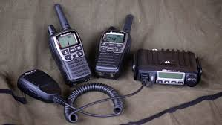
General Mobile Radio Service (GMRS)
Use Specific Channels in the same band as FRS
Multiple Privacy channels
Up to 5W on channels 1-7, 0.5W on channels 8-14, up to 50W on channels 15 -22
Range is dependent on power, channel, and terrain. From 0.3to 1 mile on channels 8-4, and up to ~60 miles channels 15-22 with open line of sight
Can be handheld units or may be a station.
Requires an FCC license to use but no test required, license is extended to household
Notes:
Pros: handheld or vehicle mounted, potential use of repeater towers for longer range if they operate in the area, 22 channels with FRS channel overlap, device to device communication. Higher power systems can operate up to 65 mile open terrain in channels 15-22 and up to ~5-10 miles in dense terrain, also has 42 privacy channels options
Cons: FCC license (but covers whole family for 10 years), various equipment requires knowledge to select units to maximize operation (transmit power, antenna types) Cannot communicate in code language (except code 10_, or more than 15 minutes continuous. Must use FCC call sign after each end. Higher power systems require a bigger power source to transmit.

Slide 18
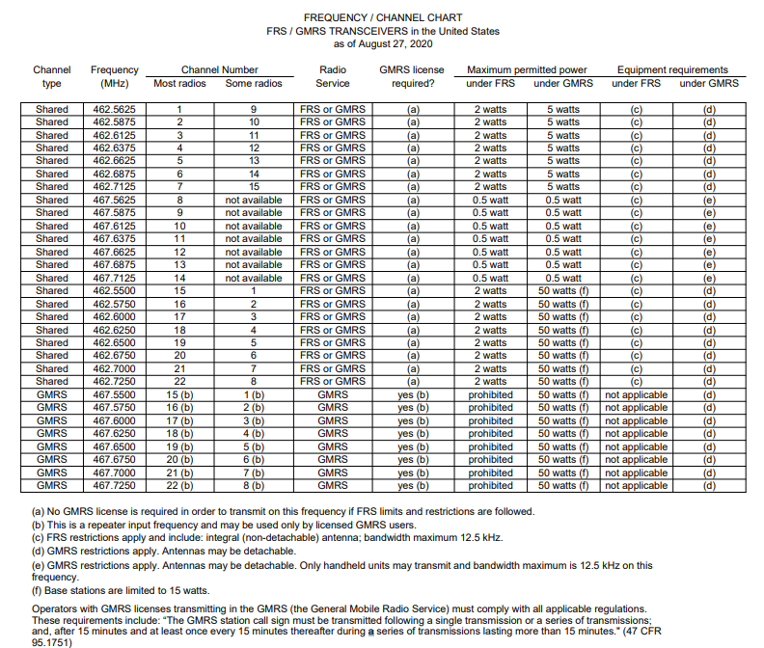
GMRS and FRS frequency and Power Chart

Slide 19
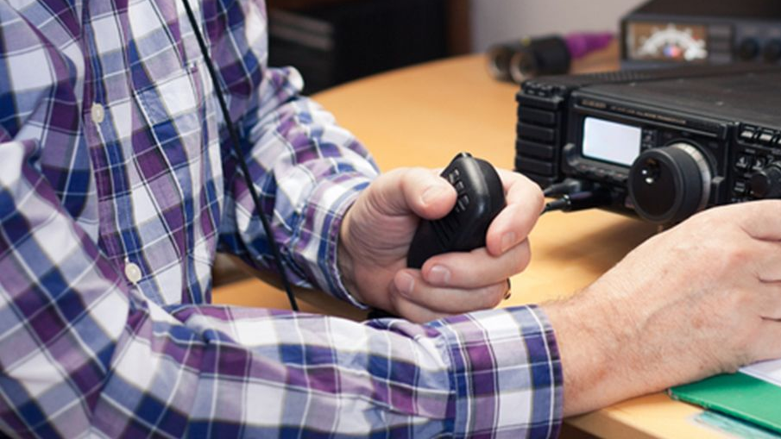
Ham Radio (slide 1)
Can Transmit depending on type between 5W to 100W
Range is dependent on power and antenna
Area has multiple repeater towers in the area which can greatly increase range of transmission
Multiple levels of FCC licensing available, and limited to individual use
  Tech – interested in talking around , limited in frequencies
  General – adding in most emergency communication, expanded frequency ranges
  Amateur Extra – shorter call sign, even more operation frequencies, ability to admin tests
Notes:
Pros: handheld, vehicle, or home powered, potential use of repeater towers for longer range if they operate in the area, potential worldwide communication
Cons: FCC license for single individual (three different types, various equipment requires knowledge to select units to maximize operation (transmit power, antenna types Must use FCC call sign after each end. Higher power systems require a bigger power source to transmit.

Slide 20
Ham Radio (slide 2)
80 Meter (Technician)
  3.525 to 4.0MHZ
160 Meter (General amateur Extra)
  1.8 to 2.0MHZ
630 Meter
  472-479 KHz
  5W Equivalent, Isotopically Radiated Power (EIRP) max except in Alaska ar 1W
2200 Meter
  135.7 to 137.8 KHz
  1W EIRP max
To operate on 2200 or 630 meters, amateurs must first register with the Utilities Technology Council

