Slide 1
WATER
PURIFICATION METHODS
(OVERVIEW)

Slide 2
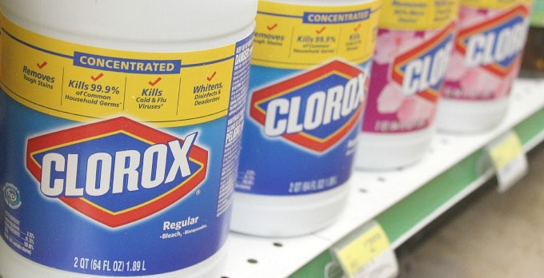
DISINFECTION WITH BLEACH
Removes: Bacteria, Viruses, Giardia
Advantages: Tablets or drops are lightweight and compact, Kills viruses, More effective when used with filtration, Inexpensive
Disadvantages: Waiting time, Not effective against Cryptosporidium or Cyclosporum

Slide 3
How Much Bleach Should I Use?
2 drops of household unscented bleach per liter or 8 drops per gallon of water.
Let stand for 30 minutes before drinking.
Works great if water is tap water sourced directly from the earth or if camping and have to gather water from natural source.
Norovirus, an intestinal disease that causes diarrhea, requires water to sit for 1 hour before consumption.
Giardia, a parasite with a protective coating, requires 45 minutes before consumption.

Slide 4
Water Purification Tablets
Chlorine in the form of pre-dosed tablets.
Drop into container of water and allow to sit for 30 to 45 minutes.
Very convenient for traveling overseas or hiking.

Slide 5
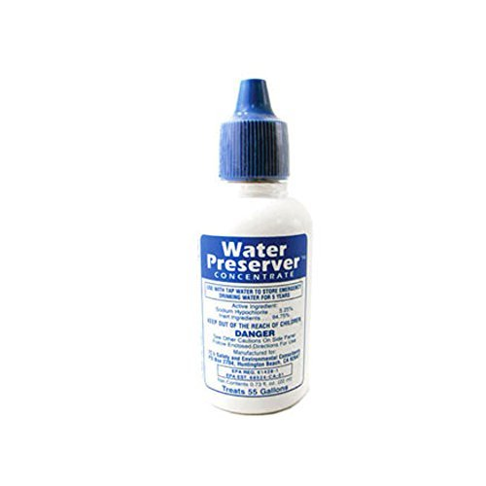
Drops and Tablets

Slide 6
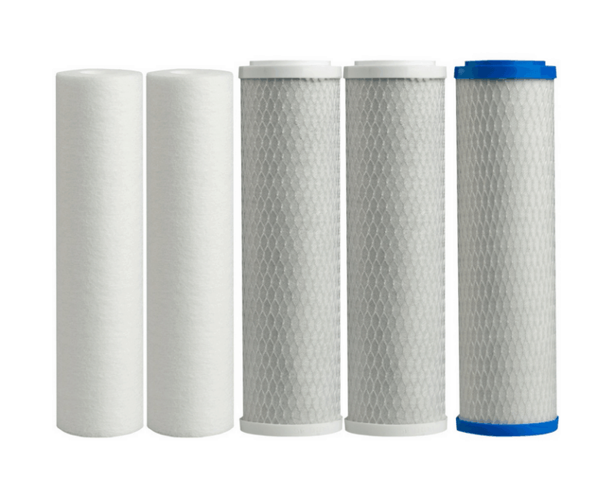
Filtration
Removes: Sediment, Bacteria, Large parasites, Some heavy metals
Advantages: Quick, Taste of water not altered significantly, Versatile, Easy to use, Come in many forms and sizes, some are portable
Disadvantages: Requires filter replacement, Not effective against viruses

Slide 7
Active carbon is highly effective in removing 81 chemicals from water.
    Able to remove 14+ types of pesticides and 12 types of herbicides from water.
    Also remove bad odor coming from chlorine-treated water.
Portable filters are convenient for travel and outdoor activities.

Slide 8
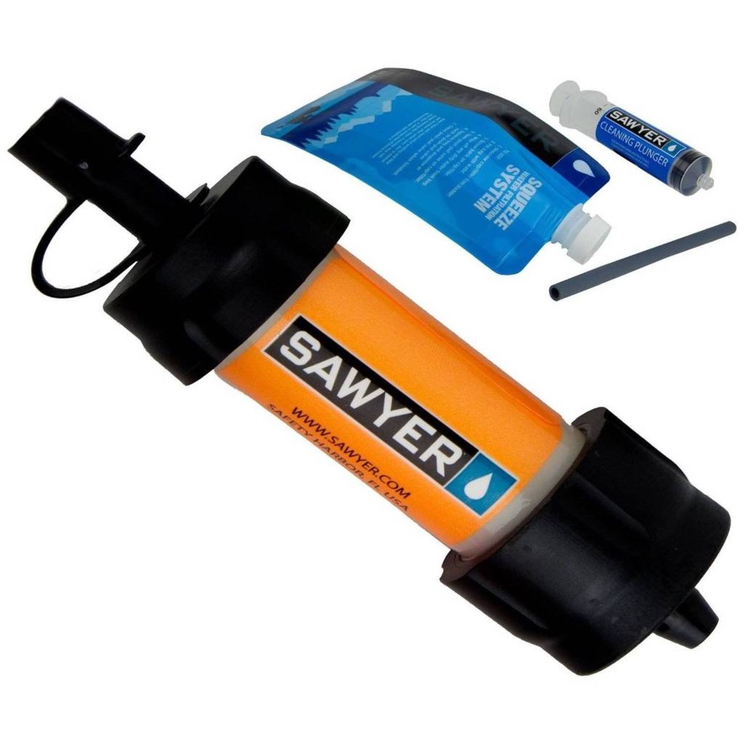
Portable “Mini” Water Filtration System

Slide 9
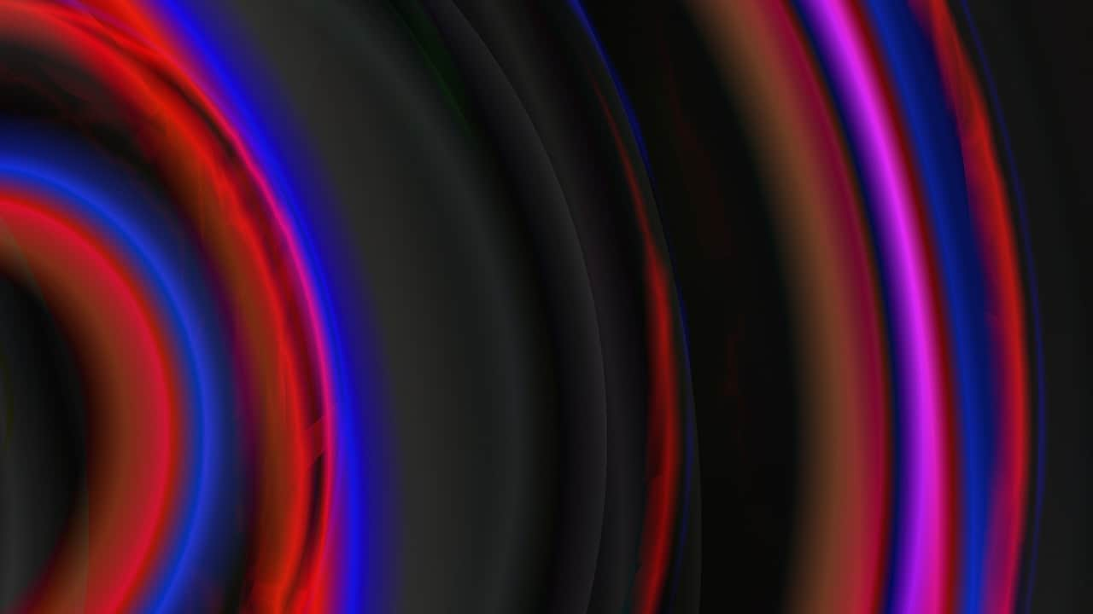
Ultra Violet Light (UV Purification)
Removes: Bacteria, Viruses, Parasites
  Advantages: Cleans water rapidly and effectively, Now available as small portable system with prefilter
      More powerful than solar purification
  Disadvantages: Expensive, Non-portable systems require electricity and are high maintenance, Does not remove heavy metals

Slide 10
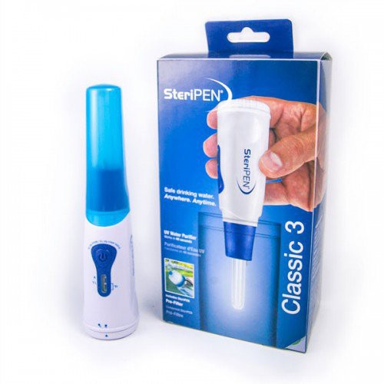
Portable UV Water Purifier
with Pre-Filter

Slide 11

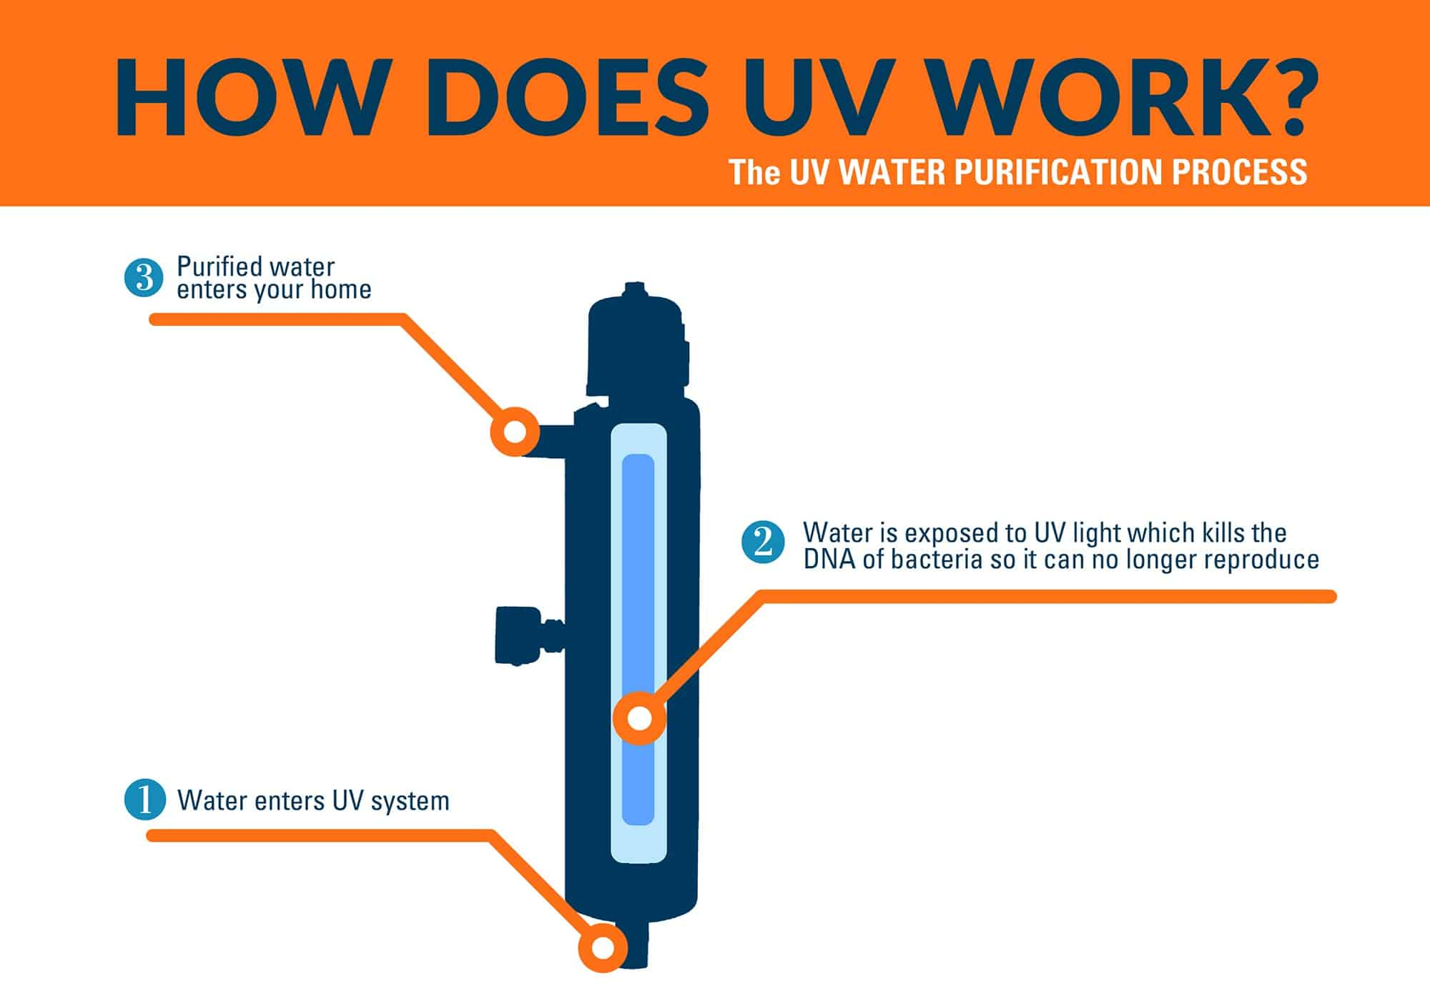

Slide 12
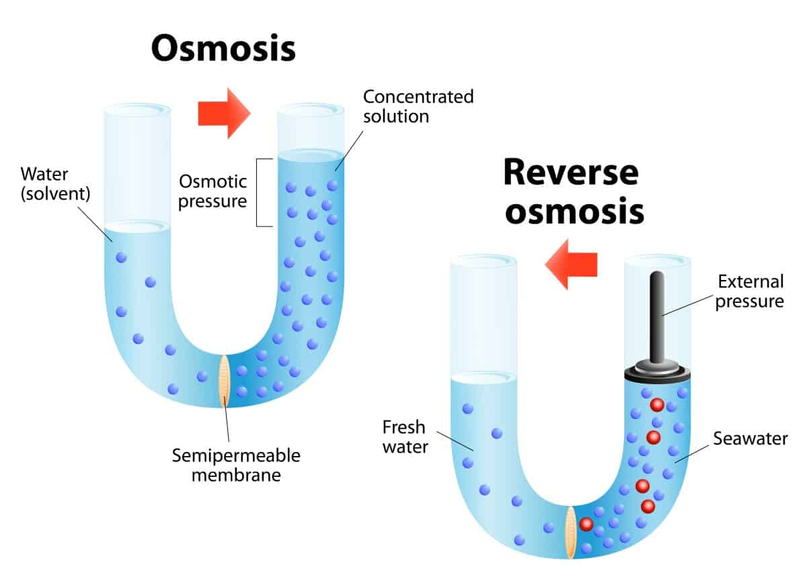
Reverse osmosis is a process that forces water through a semi-permeable membrane to remove contaminants
Is a naturally occurring process

Slide 13
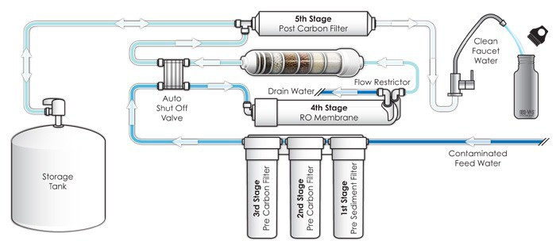
Reverse Osmosis
Removes: Bacteria, Viruses, Parasites, Impurities and Heavy metals
Advantages: Removes microorganisms effectively, Improves taste
Disadvantages: Expensive, High maintenance, will not remove certain pesticides and solvents small enough to pass through membrane

Slide 14
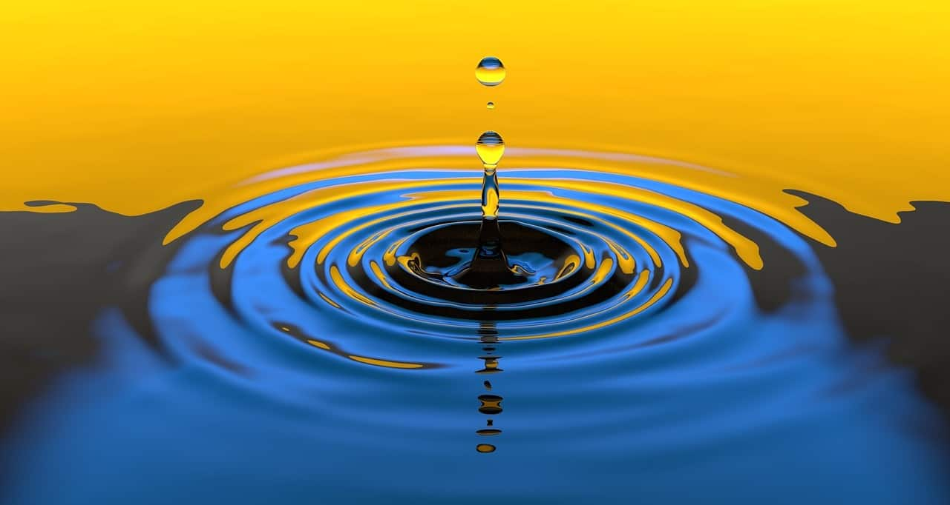
Iodine Treatment
Removes: Bacteria, Viruses, Giardia (when allowed to sit for 50+ min)
Advantages: Lightweight, Compact, More effective with filtration, Inexpensive, available in many forms (tablets, crystals, liquid, tincture)
Disadvantages: Slow, Unpleasant taste, Not effective against Cryptosporidium, Deadly at high concentrations

Slide 15
How to Use Iodine to Purify Water
For tincture iodine, combine 2 drops for every quart of clear water.
    For cloudy water, use 10 drops per quart.
Let the solution stand for at least 30 minutes.
Follow manufacturer’s instructions when using crystal or tablet iodine (typically, a bottle of crystal iodine can treat up to 2000 quarts of water).
Iodine is sensitive to light and should always be stored in a dark bottle

Slide 16
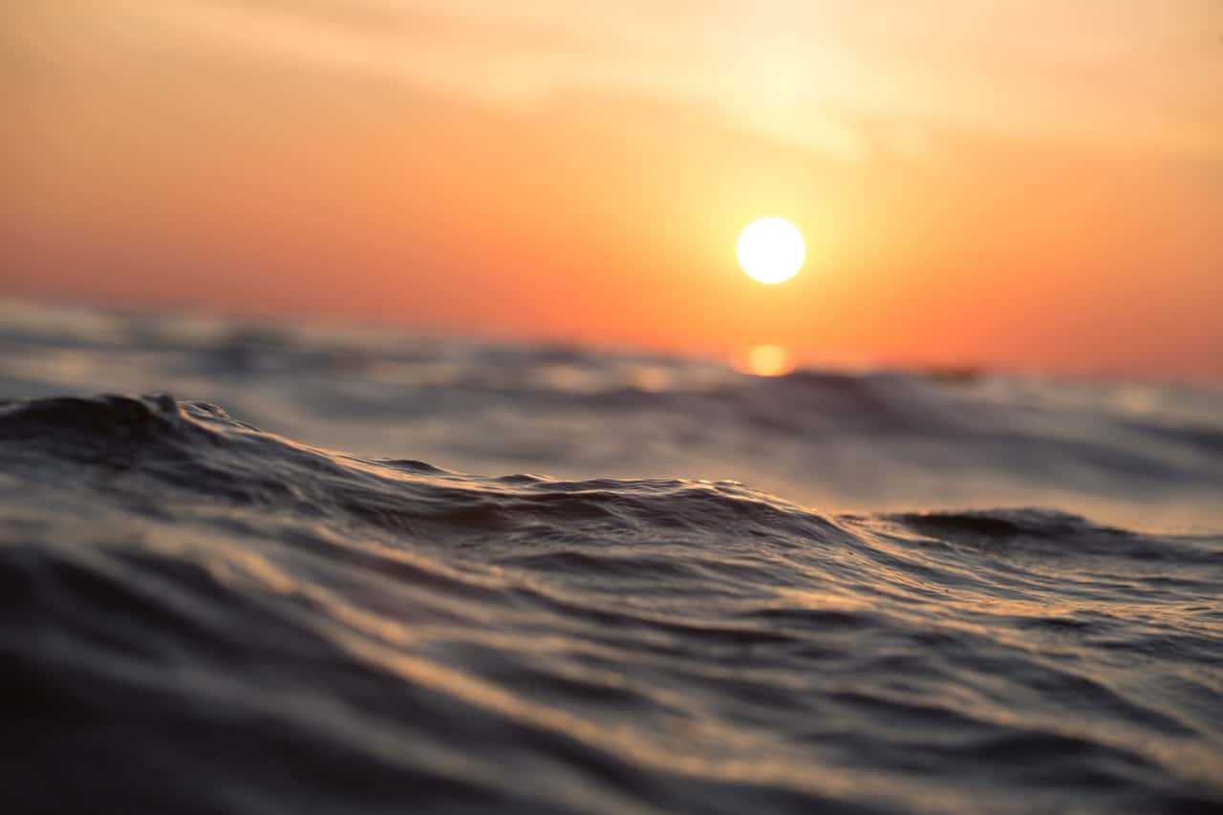
Solar Purification
Removes: Bacteria, Viruses
Advantages: Inexpensive, Easy to set up
Disadvantages: Depends heavily on weather, Very slow even on sunny days

Slide 17
How to Use the Sun to Purify Water
Can disinfect water through use of plastic bottles and sunlight.
Remove labels and paper from the bottles and ensure they have no scratches.
Fill with water to about 3/4 full
Shake for 30 seconds to activate oxygen
Fill to brim with water, cover, lay bottle horizontally, and expose to direct sunlight
For best results, choose location where direct sun light will be undisturbed for 6+ hours (increase exposure time to 2 days if cloudy)

Slide 18
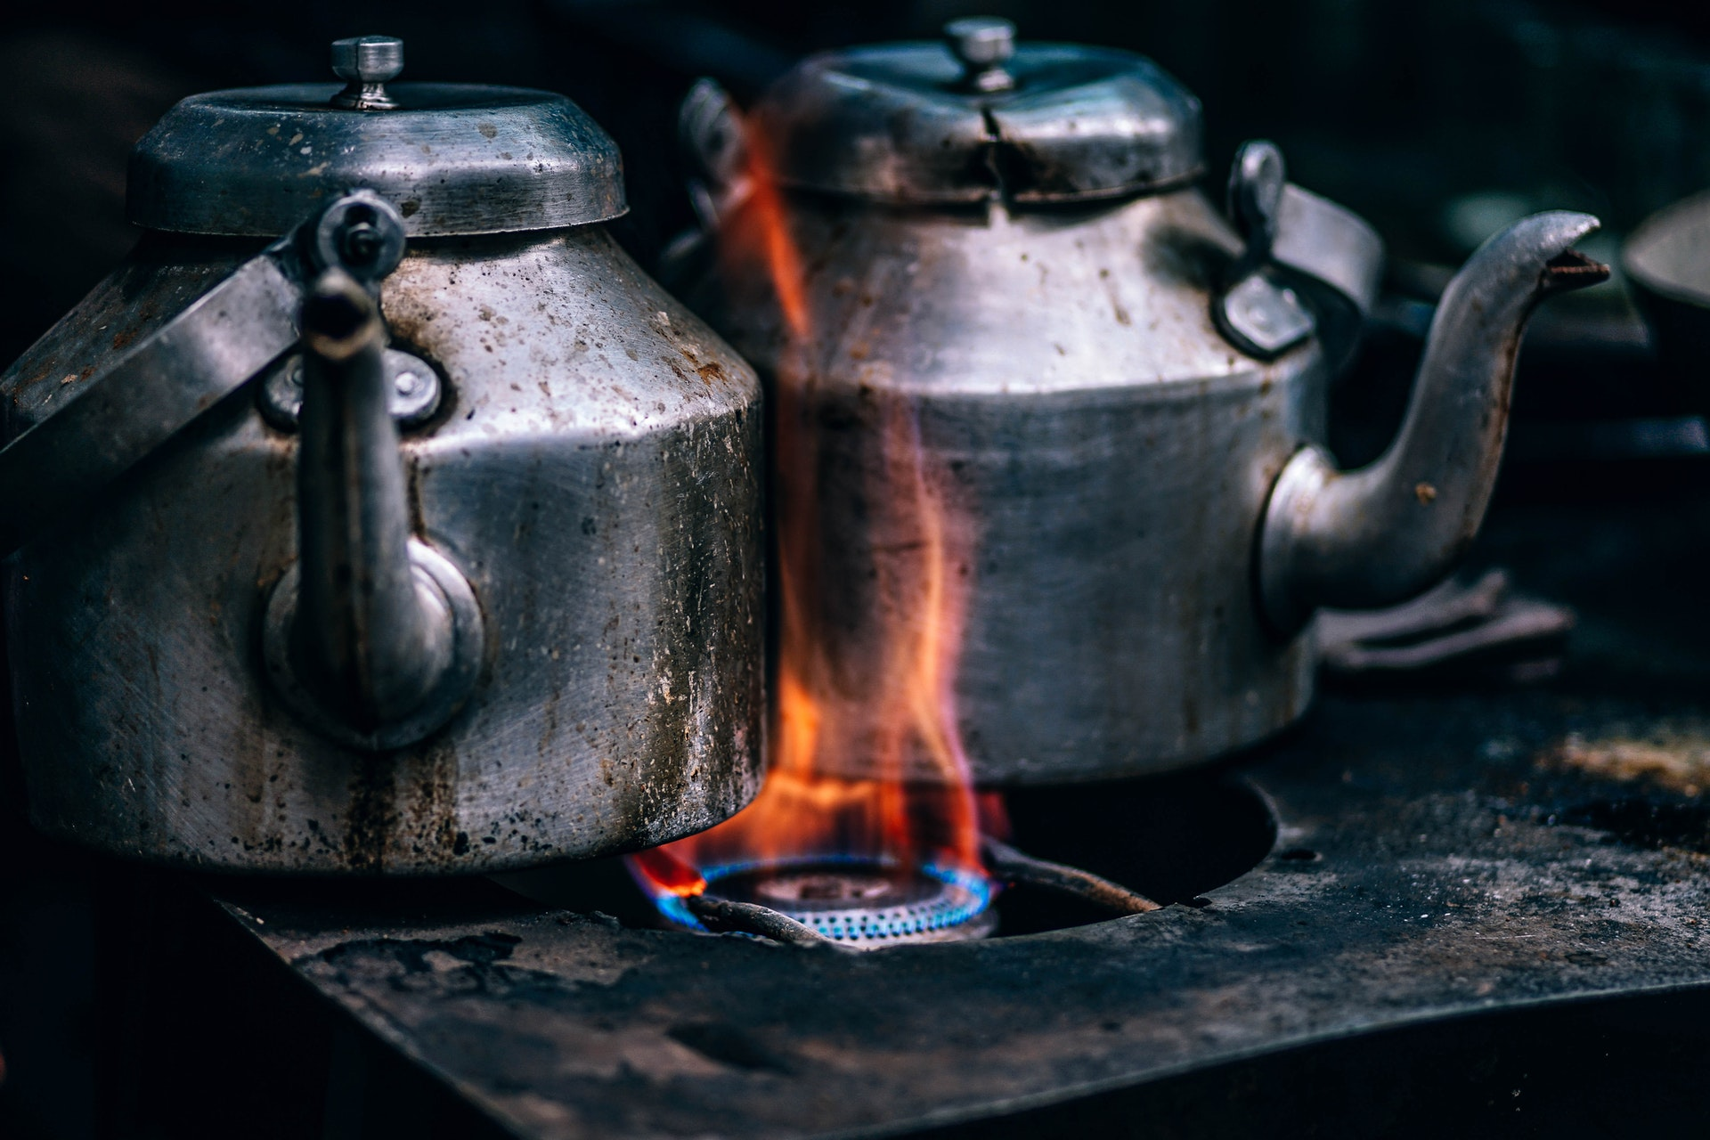
Boiling
Removes: Bacteria, Viruses, Parasites
Advantages: Free of all pathogens if done correctly
Disadvantages: Slow and inconvenient, Flat water taste

Slide 19
How to Purify Water with Boiling
Filter large contaminants through clean cloth or coffee filter if water is cloudy
Bring water to a boil (bubbles are a visual sign that water has reached 212 degrees Fahrenheit/100 degrees Celsius)
Let boil for 1 minute (at elevations above 5,000 feet, boil for 3 minutes)
Let water cool, then pour into clean container and cover
Boiled water will have flat taste- swishing water around before drinking or transferring it from one container to another can improve taste

Slide 20
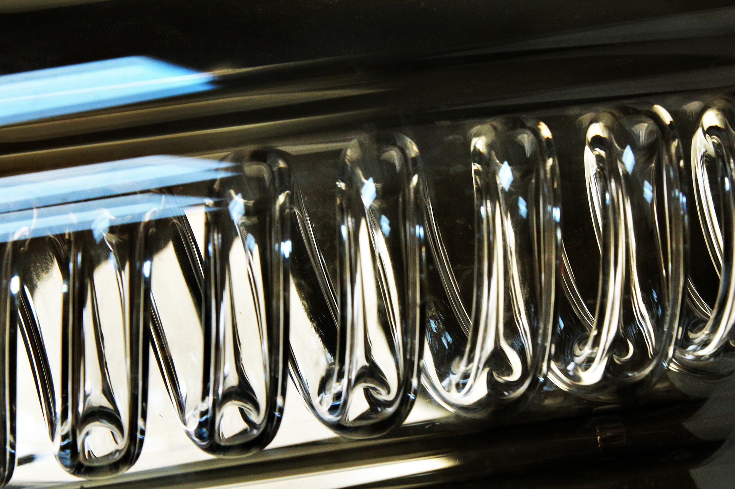
Distillation
Removes: Bacteria, Viruses, Parasites, Impurities and Heavy Metals
Advantages: Removes all pathogens and heavy metals
Disadvantages: Slow and inconvenient, Free of minerals as well

Slide 21
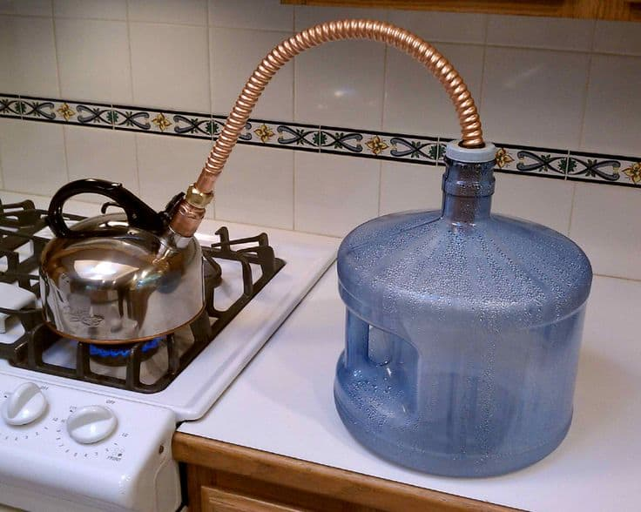
How to Distill Water
Home distillation units sit on countertop.
Requirements:
Boiling pot
Container to collect condensation
Tube to allow vapor to travel through
Heat source

