Slide 1
Tips and Tricks
for
Successful
Gardening

Slide 2
Housekeeping
Questions at the end please
Legal gobbledigook

Slide 3
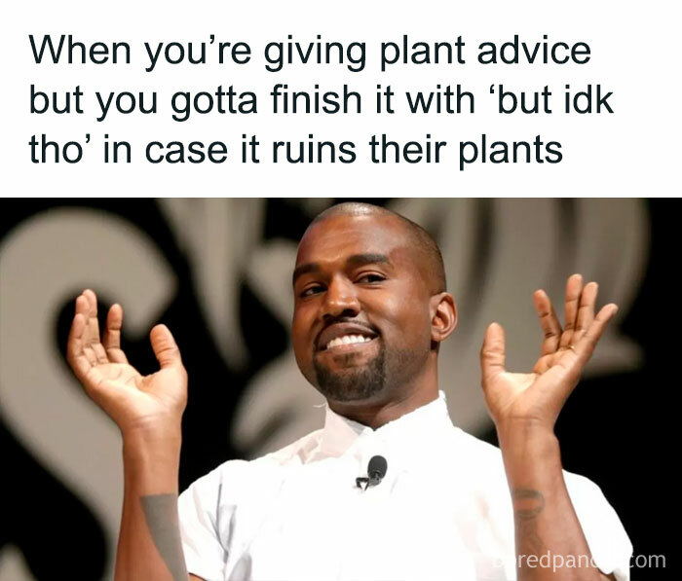

Slide 4
Know your audience
How many of you have been gardening for more than three years?

Slide 5
Know your audience
How many of you have been gardening for more than three years?
Less than three years?

Slide 6
Know your audience
How many of you have been gardening for more than three years?
Less than three years?
Never

Slide 7
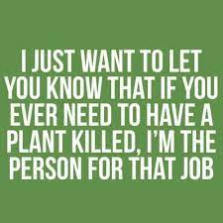
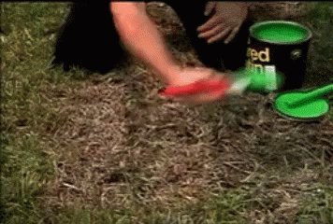
Know your audience
You +

Slide 8
Everyone
can
GARDEN
Biblical evidence
Evolutional
Historical

Slide 9

Know your why

Slide 10
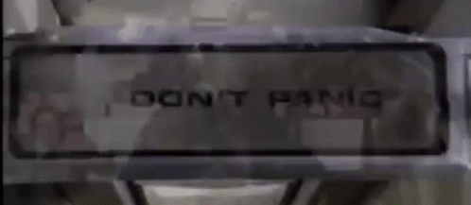

Slide 11
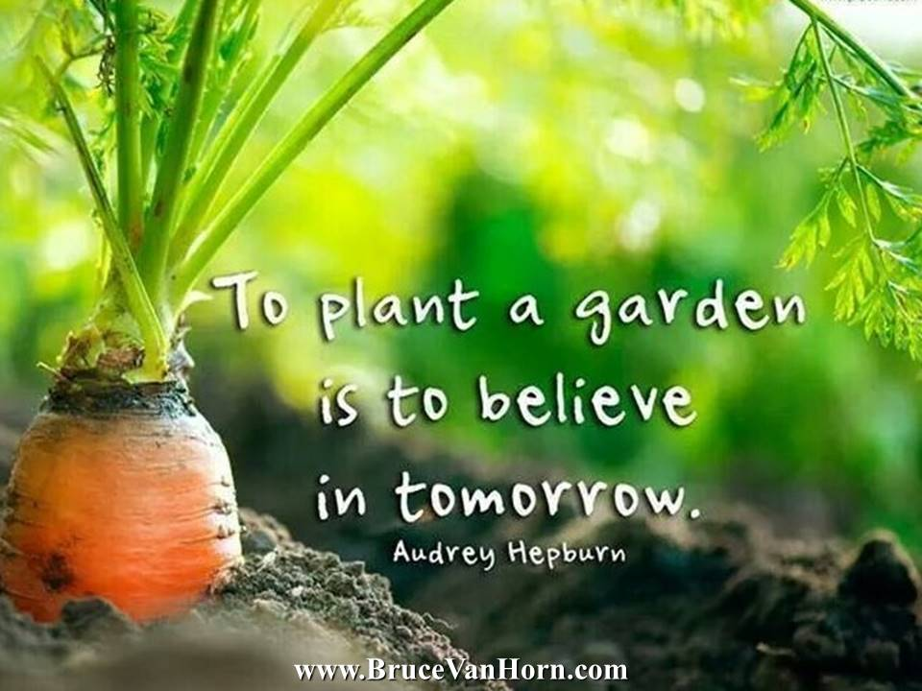

Slide 12
Variety
Potatoe
Tomato
Summer Squash
Watermelon
Basil
Carrots
Apples

Slide 13
Variety
Potato 40
Tomato 91
Summer Squash 24
Watermelon 26
Basil 18
Carrots 21
Apples 7500

Slide 14


Get Rich!!!! $$$$$

Slide 15

IT’S FUN!!!

Slide 16
Gardening Principles
“Before I was a gardener. Gardening was putting a seed into the ground watering it and collecting a harvest at the end. When I started to learn how to garden gardening was no longer putting a seed into the ground watering it and collecting a harvest. Now that I understand how to garden I am just putting a seed into the ground watering it and collecting a harvest at the end.”
Bruce Lee (If he had been a gardener)

Slide 17
JUST DO IT
PLEASE

Slide 18

SUN

Slide 19

WATER

Slide 20

TIME+RETENTION+VOLUME =

Slide 21
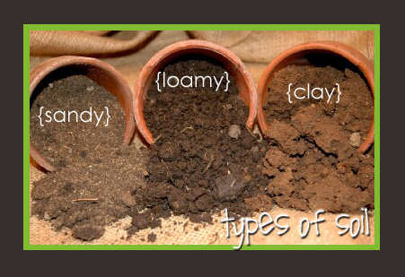
Soil

Slide 22
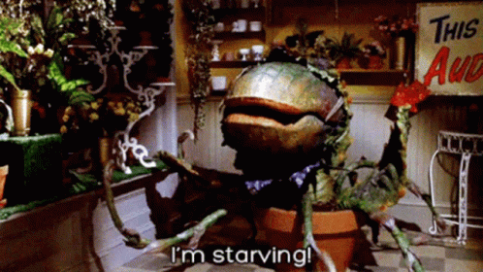
Nutrition

Slide 23
“There’s room for everyone in this world
if everyone makes some room
won’t you move over and share this world
Everyone make some room”
Helen Reddy Pete’s Dragon

Slide 24
Menu
Natural Synthetic
Not processed Water soluble
Not immediately available Overrides soil biology
Best for in ground and Best for containers
raised beds Fish emulsion is
natural and water
soluble

Slide 25
Natural
Takes time
Needs a good soil biome to become available for plants
can make your own

Slide 26
Synthetic
Follow the directions
Make sure you are using the right type (flower or vegetable or general purpose)
can be used for diagnostics

Slide 27

Types of Plants
Seed or Transplant?

Slide 28
Seed
Inexpensive?
Start indoor or in its forever home?
Onions, Tomatoes, and Peppers
Corn
Indoor harden off

Slide 29
Transplants
Ready to go (time saving)
Big Box Store VS Local Nursery

Slide 30
Annuals, Perennials, and Growing Zones
Annuals = one and done.
Most vegetables in our gardens are annuals
Perennials = Here to stay unless you remove them.
Asparagus, strawberries, fruit trees, and mint mint mintmint mint mint mint mint mint MIIIIIIIIIIIIIIIIIIIIIIIIIIIIIIIIIIIIIIIIIIIIIIIIIIIIIIIIIIIIIIIIIIIIIIIIIIIIIIIIIIIIIIIIIIIIIIIIIIIIIIIIIIIIIIIIIIIIIIIIIIIIIIIIIIIIIIIIIIIIIIIINT

Slide 31
USDA Zone 7
Between 90 and 120 days of consecutive temperatures above freezing

Slide 32
The plethora of places you can put your plants!
In ground
Raised beds
Containers

Slide 33
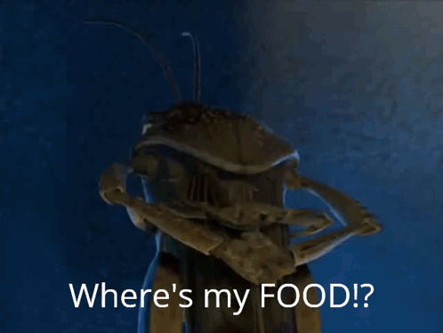

Pest and Disease

Slide 34

Stay healthy

Slide 35

Fencing, poison, make it gross, or fatten them up

Slide 36

Tools

Slide 37

“Don’t believe everything on the Internet!”
Abraham Lincoln

Slide 38
Resources and Help
You are not alone
Square Foot Gardening
By Mel Bartholomew
Local classes all FREE!!!
Bartley Ranch Tuesdays through March
Rail City Garden Saturdays all year
Moana Nursery Email
michaelsapples.com
Master Gardeners

Slide 39
Master Gardeners
Desk Hours
10 a.m. - 2 p.m.
Tuesdays, Wednesday, & Thursday
mastergardners@unce.unr.edu
(775) 336-0265

Slide 40
Exit Survey

Slide 41
