Slide 1
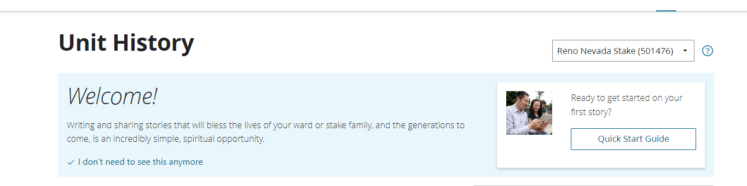
Unit History Tool

Slide 2
Go over:
Purpose of ward & stake histories
*New* Unit History Tool

Slide 3
33.7.1
Ward and Stake Histories
The Lord has commanded that “a history of all the important” matters concerning His Church be written and kept (Doctrine and Covenants 69:3; see also verse 5; Alma 37:2).
Each unit in the Church is to document important matters concerning the unit. These matters include historical accounts from unit leaders.
Keeping a history is a spiritual work that will strengthen the faith of those who write and read it. Documenting stories throughout the year will improve the quality of the history.
Stake and ward priesthood and organization leaders contribute stories using the Unit History tool on ChurchofJesusChrist.org. Stake and ward clerks have the primary responsibility to organize and coordinate this effort. The stake presidency and bishopric may call a stake or ward history specialist to help. Additional instructions are available in the tool’s Quick Start Guide.
Members may use the Unit History tool to view stories that have been published by their ward and stake leaders. Published stories are automatically preserved by the Church.

Slide 4
Where are the histories from the past, prior to the new Unit History Tool?
Where can I find the history of Pres. Woodman’s ward, when he was Bishop? Or Sister Woodman’s reflections as Stake RS President?

Slide 5
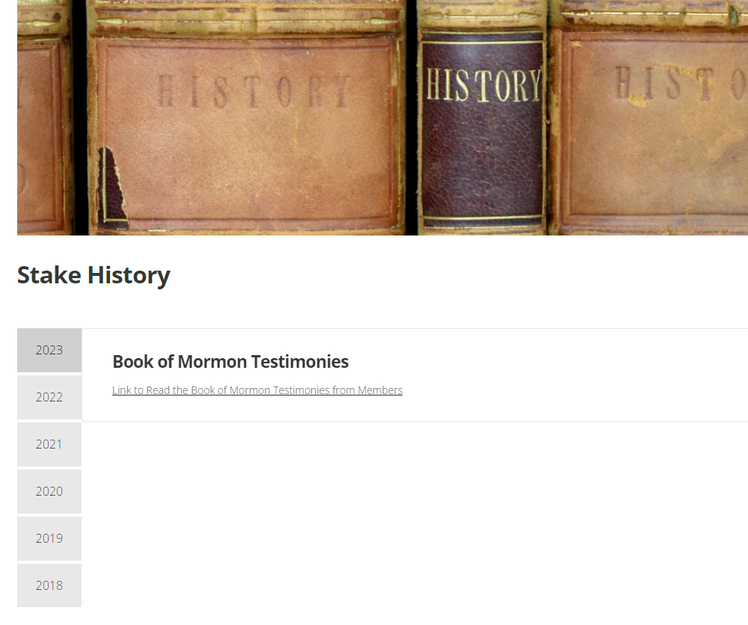
https://renonvstakeinfo.org/stake-history/

Slide 6
Process
Who write & approves?
How to create a story
How to send an invite

Slide 7
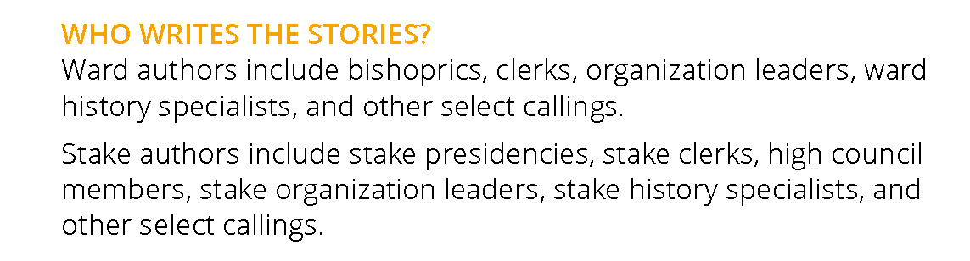
WHO WRITES THE STORIES

Slide 8
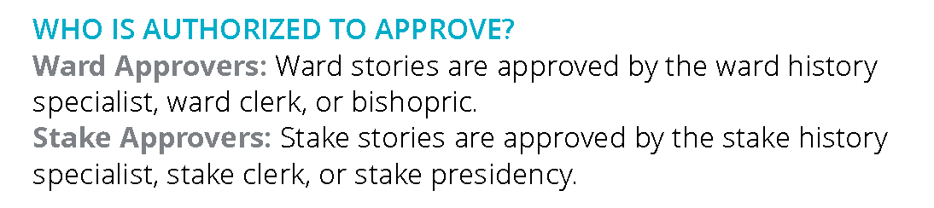
WHO IS AUTHORIZED TO APPROVE?
Notes:
Document: Creating Ward and Stake Histories_Using the Unit History Tool.pdf

Slide 9
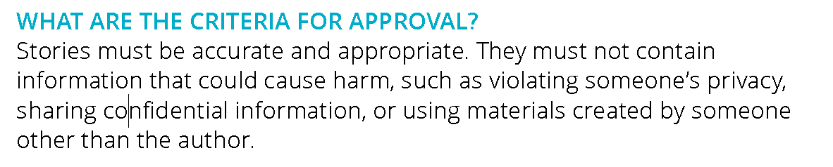
APPROVAL CRITERIA
Notes:
Document: Creating Ward and Stake Histories_Using the Unit History Tool.pdf

Slide 10
How to create a story

Slide 11
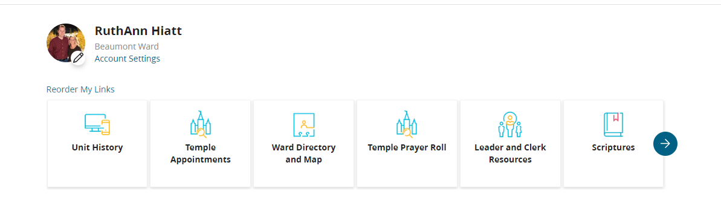
Log into My Home Page on churchofjesuschrist.org. The My Links can be reordered, if there is a preference to have the Unit History icon listed first, as indicated in the example from RuthAnn’s page:

Slide 12

Top, right hand corner, use the pull-down menu to Create Story

Slide 13
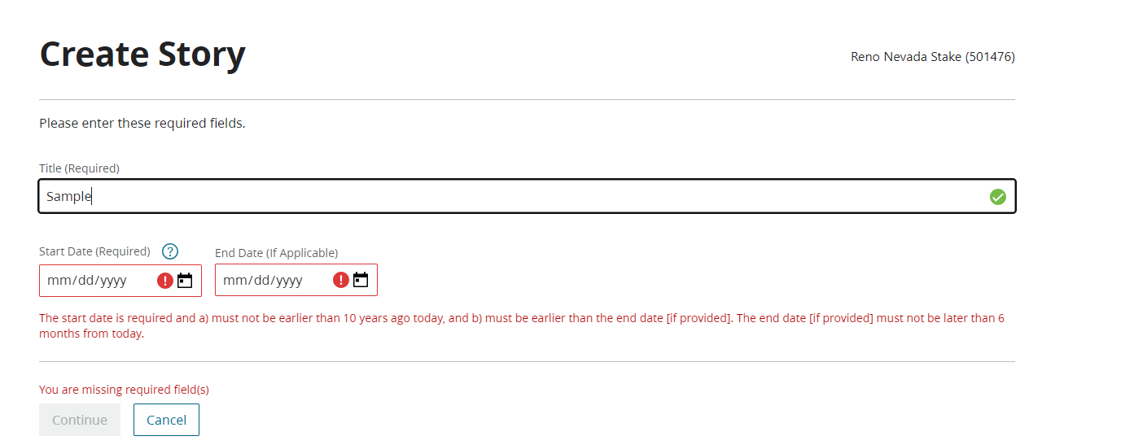
**Title & date can be adjusted later**

Slide 14
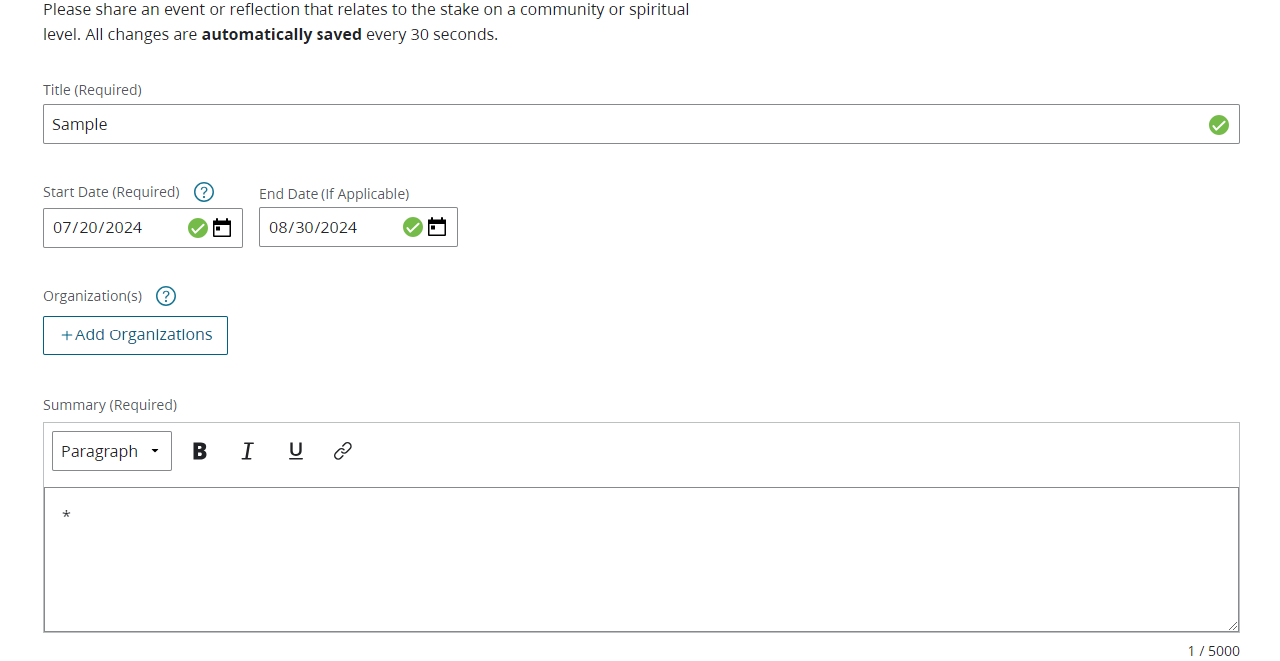
The Summary needs to have at least one value in it. It is recommended that even when uploading a PDF, put at least the first paragraph from the PDF in the summary, with instructions at the end to open the PDF for more information.
**Suggestion: Put date of event in title**

Slide 15
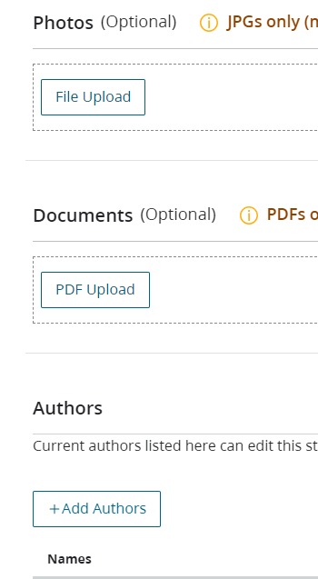
Photos and documents may be uploaded from this page, and if it is co-authored, click on +Add authors

Slide 16
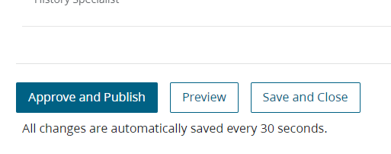
Once finished, click on Approve and Publish, or, if needed, Save and Close and come back to it later, and then publish.

Slide 17
How to send an invite

Slide 18
Log into My Home Page on churchofjesuschrist.org and go into Unit History

Slide 19
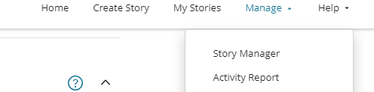
Top, right hand corner, use the pull-down menu on Manage and click on Story Manager

Slide 20
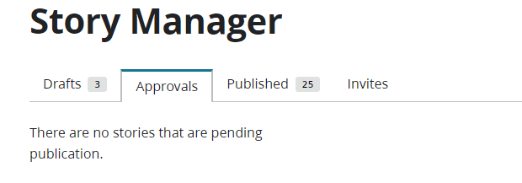
Click on Invites tab
Fill in the page with 1) Recipient (an entire organization can be selected, if this is the preference) 2) Title of the event 3) Start Date/End 4) Notes and directions, as needed 5) Send email

Slide 21
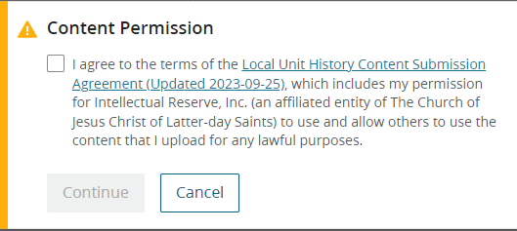
Pictures: What is ok & what isn’t?
https://www.churchofjesuschrist.org/legal/local-unit-history-submission-agreement?lang=eng&country=go
When uploading a photo this screen will pop up.

Slide 22
33.7.1
Ward and Stake Histories
The Lord has commanded that “a history of all the important” matters concerning His Church be written and kept (Doctrine and Covenants 69:3; see also verse 5; Alma 37:2).
Each unit in the Church is to document important matters concerning the unit. These matters include historical accounts from unit leaders.
Keeping a history is a spiritual work that will strengthen the faith of those who write and read it. Documenting stories throughout the year will improve the quality of the history.
Stake and ward priesthood and organization leaders contribute stories using the Unit History tool on ChurchofJesusChrist.org. Stake and ward clerks have the primary responsibility to organize and coordinate this effort. The stake presidency and bishopric may call a stake or ward history specialist to help. Additional instructions are available in the tool’s Quick Start Guide.
Members may use the Unit History tool to view stories that have been published by their ward and stake leaders. Published stories are automatically preserved by the Church.

Slide 23
How will members of the ward learn about the new Unit History Tool & the entries submitted?
How will members of the Ward Council learn about the new Unit History Tool?
Those implementing the new Unit History Tool, how has it been a blessing? What are key elements to getting members to respond & write?

Slide 24
How will members of the ward learn about the new Unit History Tool

Slide 25
How will members of the Ward Council learn about the new Unit History Tool?

Slide 26
Those implementing the new Unit History Tool, how has it been a blessing? What are key elements to getting members to respond & write?

