Slide 1
Staying cool when the power goes out

Slide 2
WASHINGTON (AP) — Get ready for several years of even more record-breaking heat that pushes Earth to more deadly, fiery and uncomfortable extremes, two of the world's top weather agencies forecast.
There's an 80% chance the world will break another annual temperature record in the next five years, and it's even more probable that the world will again exceed the international temperature threshold set 10 years ago, according to a five-year forecast released Wednesday by the World Meteorological Organization and the U.K. Meteorological Office.

Slide 3
“Higher global mean temperatures may sound abstract, but it translates in real life to a higher chance of extreme weather: stronger hurricanes, stronger precipitation, droughts,” said Cornell University climate scientist Natalie Mahowald, who wasn't part of the calculations but said they made sense. “So higher global mean temperatures translates to more lives lost.”

Slide 4
Heat exhaustion is an early stage of heat stroke. The person feels excessively tired, weak, and nauseous, and may feel dizzy and even briefly pass out. The skin is cool and clammy and may appear either flushed or pale. Have the person sit or lie down in a shady location and give cool drinks — the colder, the better. Try anything to cool the victim down: Loosen or take off extra clothes, sponge with cold water, and place him or her near a fan. If the person does not get better or symptoms get worse, seek medical care immediately.

Slide 5
Heat stroke is a very dangerous condition. The body stops sweating, and the internal temperature climbs to high levels, although the person may get what feels like chills. The skin may be quite dry and hot. People with heat stroke may be confused, agitated and have blurry or double vision. Have the person lie down and call 911 at once while others continue efforts to cool the victim down. They may also lose consciousness.

Slide 6
Revelations 16:
8 And the fourth angel poured out his vial upon the sun; and power was given unto him to scorch men with fire.
9 And men were scorched with great heat, and blasphemed the name of God, which hath power over these plagues: and they repented not to give him glory.

Slide 7
Jonah 4:
5 So Jonah went out of the city, and sat on the east side of the city, and there made him a booth, and sat under it in the shadow, till he might see what would become of the city.
6 And the Lord God prepared a gourd, and made it to come up over Jonah, that it might be a shadow over his head, to deliver him from his grief. So Jonah was exceeding glad of the gourd.
7 But God prepared a worm when the morning rose the next day, and it smote the gourd that it withered.
8 And it came to pass, when the sun did arise, that God prepared a vehement east wind; and the sun beat upon the head of Jonah, that he fainted, and wished in himself to die, and said, It is better for me to die than to live.

Slide 8
Isaiah 4:
5 And the Lord will create upon every dwelling place of mount Zion, and upon her assemblies, a cloud and smoke by day, and the shining of a flaming fire by night: for upon all the glory shall be a defence.
6 And there shall be a tabernacle for a shadow in the daytime from the heat, and for a place of refuge, and for a covert from storm and from rain.

Slide 9
NV Energy
Enhanced safety settings are put into place when fire risk conditions are elevated. These settings are used with devices to de-energize the lines when a fault is detected, reducing the chance of a potential fire ignition.
Our team of meteorologists consistently monitors weather and fire conditions around the company's service area throughout the year. The team provides regular wildfire briefings to share the most up-to-date weather data with the company's operations teams, who then make adjustments to the electric system based on the expected conditions. Accordingly, when the risk of wildfire is elevated, the company will place some of its system equipment on more sensitive settings to mitigate the risk of igniting a fire if a power line is contacted.
These settings result in lines being de-energized more rapidly when there is a fault, which is commonly caused by animals, birds, or airborne debris coming into contact with our equipment. When these settings are in place, there is an increased potential for outages. Moreover, customers may experience longer-than-typical outages as our field crews work to patrol the lines before restoring power.
We appreciate your patience during such outages, as we all strive to promote safety and reduce the risk of wildfire.

Slide 10
Eaton fire Jan 7-31
Camp fire Nov 8 2018
Davis fire Sept 7-25 2024
Motorcyclist in Death Valley

Slide 11
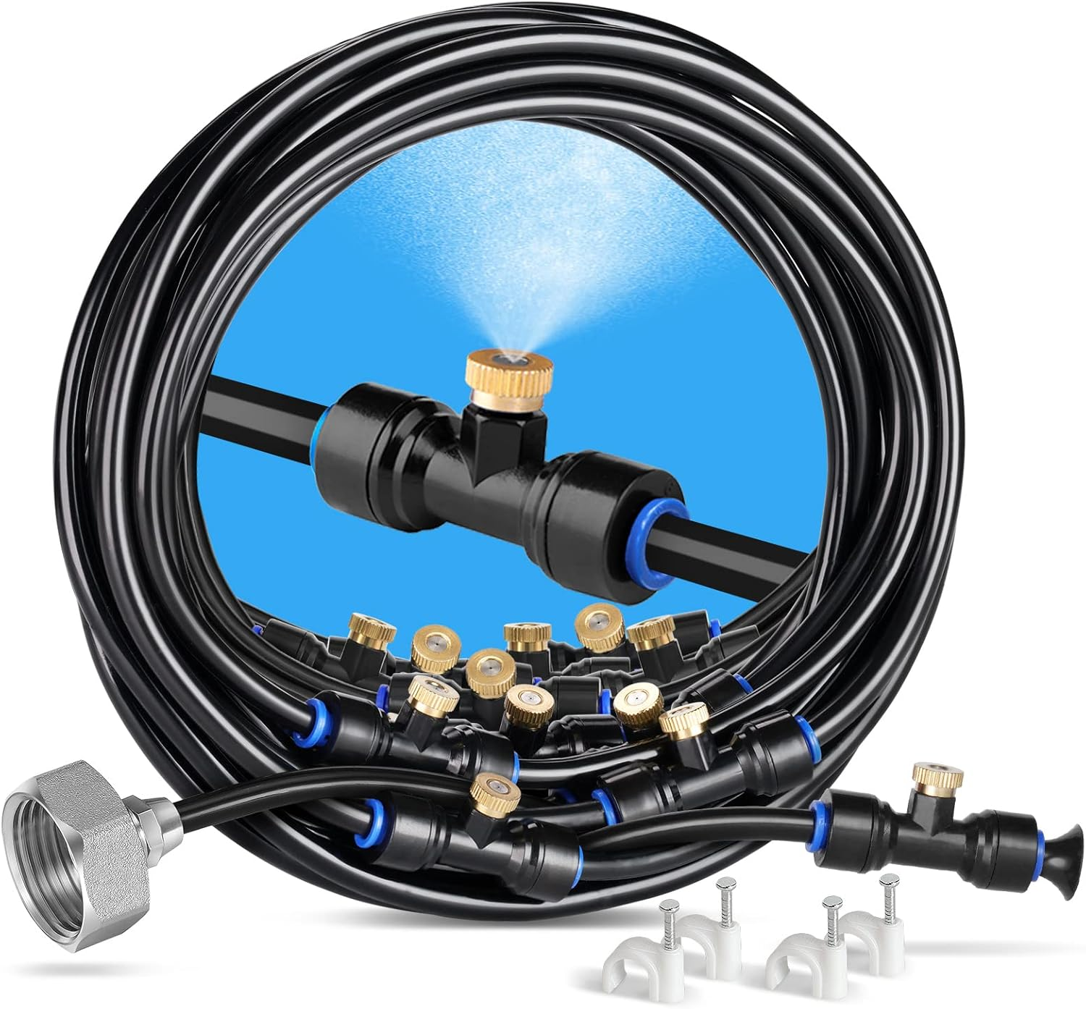
Most important element in cooling off without power is water!
Tap or hose
Runing though the sprinklers, Cold shower, feet in cold water bath, cold plunge, misters

Slide 12
River, pond, Swiming pool
Wetting a towel or sheet
Wetting a cooling towel, or hat Freezing your slightly damp hand towel in u shape
Ice cubes , cold drinks
Hand fan with wet clothing

Slide 13
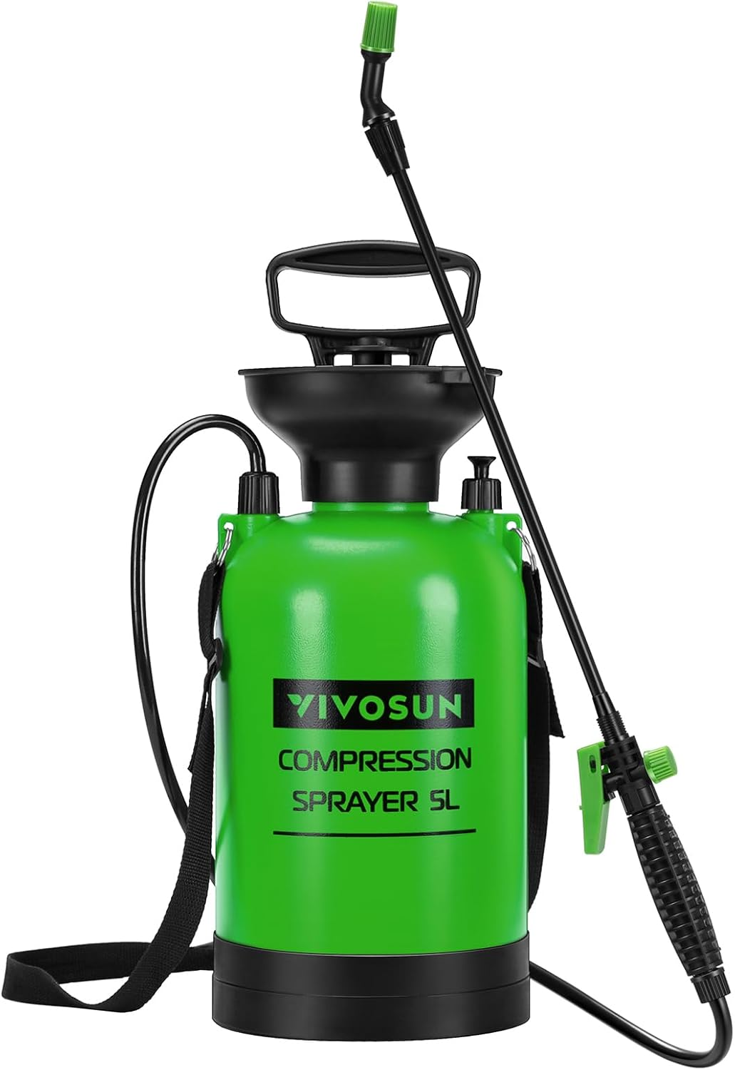
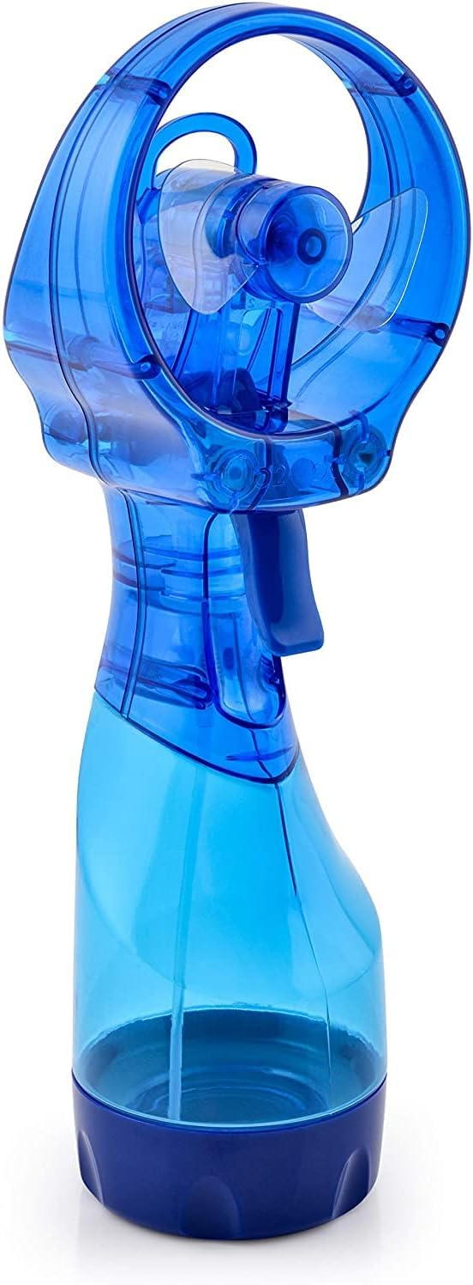
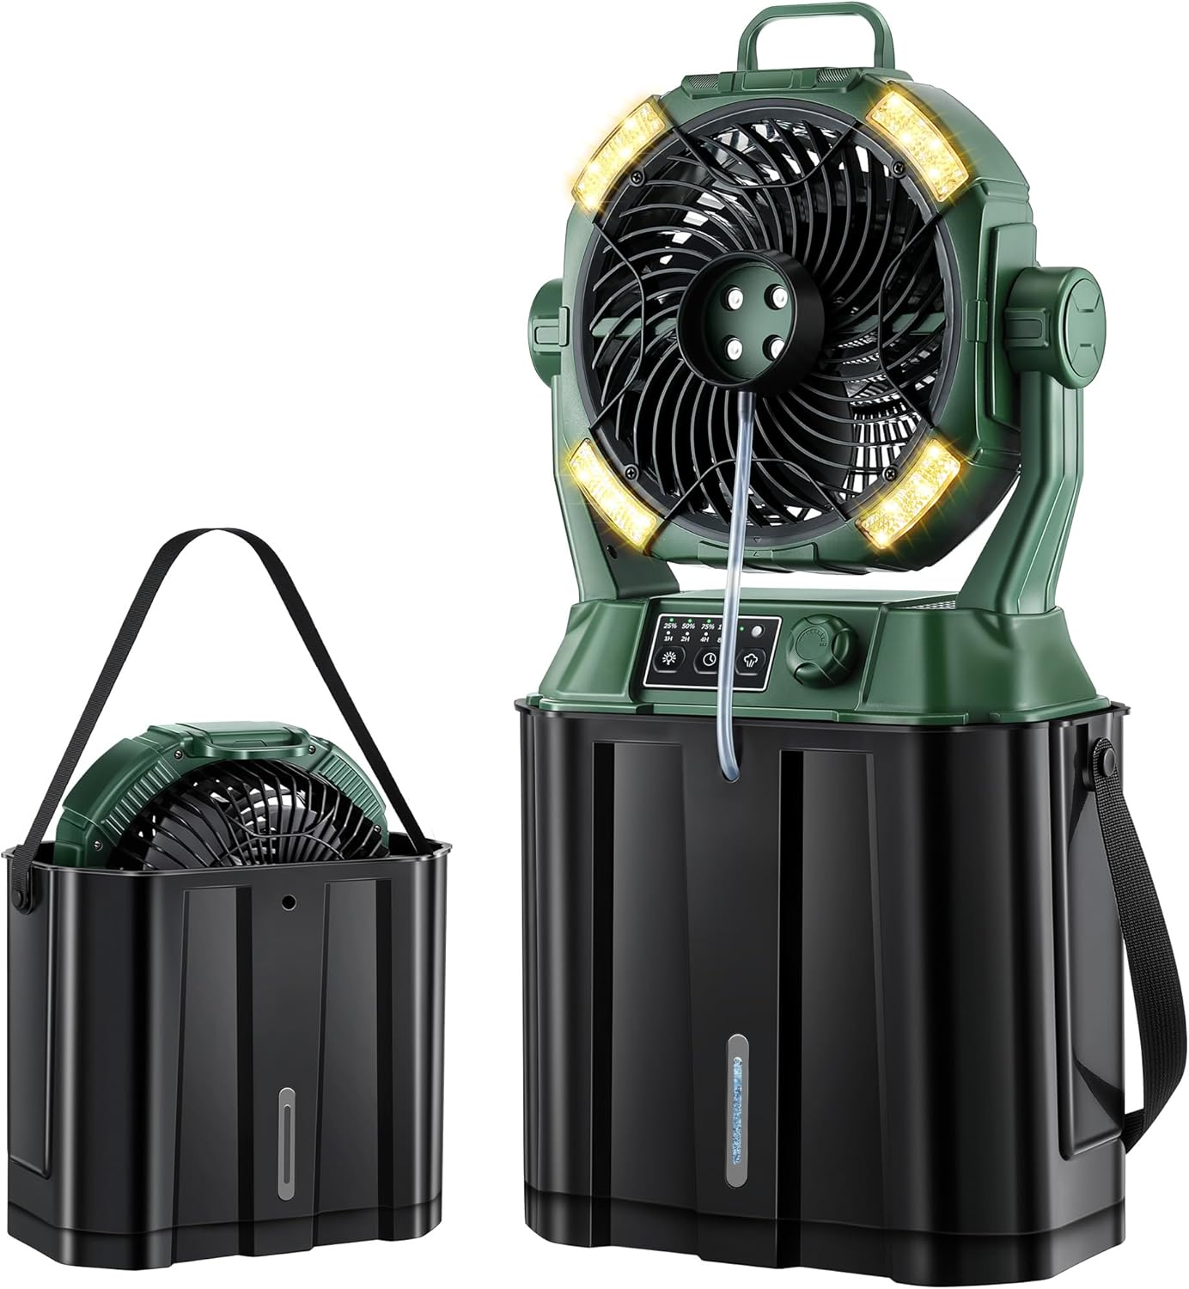

Slide 14
Having access to clean water
Storing water
To store water long-term, use food-grade plastic containers, food-grade glass jars, or metal tanks, all of which should be thoroughly cleaned and sealed. Store the water in a cool, dark place, ideally between 50-70°F (10-21°C), away from direct sunlight and toxic substances. Rotate your stored water every six months to a year to ensure freshness.
Here's a more detailed breakdown:
1. Containers:
Food-grade plastic:
.
Choose BPA-free food-grade plastic containers, ensuring they are properly cleaned and sealed to prevent contamination.
Food-grade glass:
.
Glass jars are another excellent option, as they don't leach chemicals and are resistant to degradation.
Metal Tanks:
.
Metal tanks are durable and suitable for large-scale storage, but ensure they are properly cleaned and sealed.

Slide 15
. Storage Conditions:
Cool, Dark Place:
Store water in a cool, dark, and dry place, such as a basement or pantry, to prevent algae and bacterial growth.
Temperature Control:
Maintain temperatures between 50-70°F (10-21°C) to minimize spoilage.
Away from Sunlight:
Protect water from direct sunlight, which can promote algae growth and affect taste.
Safe from Contamination:
Keep containers away from chemicals, pesticides, and other potential contaminants.

Slide 16
. Disinfection & Treatment:
Disinfection:
You can disinfect tap water by adding a small amount of unscented chlorine bleach (e.g., 1/8 teaspoon per gallon 8 drops). 1 ¾ teaspoons for 50 gal container
Purified Water:
Distilled or purified water is less likely to contain contaminants and can last longer.
Boiling:
Boiling water can kill many bacteria and viruses, but it doesn't remove all contaminants.
Water Purification Tablets:
Use water purification tablets to treat water before storing it.

Slide 17
4. Rotation:
Regular Rotation: Rotate your water supply every six months to a year to ensure you're using fresh water.
Label Containers: Label each container with the storage date to track rotation.
5. Other Considerations:
Cleanliness: Always ensure containers are clean and dry before filling them with water.
Sealing: Use tight-fitting lids to prevent contamination.
Inspecting: Regularly inspect containers for leaks or signs of damage.
Taste: While stored water can last indefinitely, taste can change over time, so it's advisable to rotate your supply regularly.

Slide 18
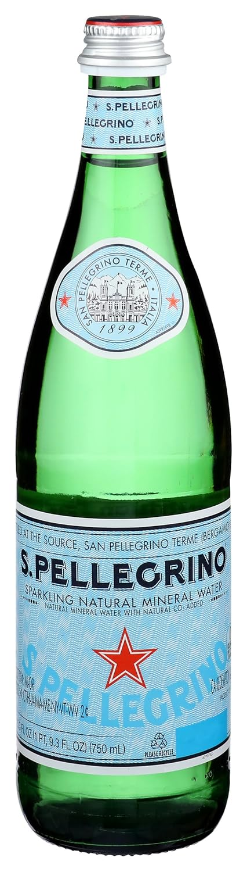
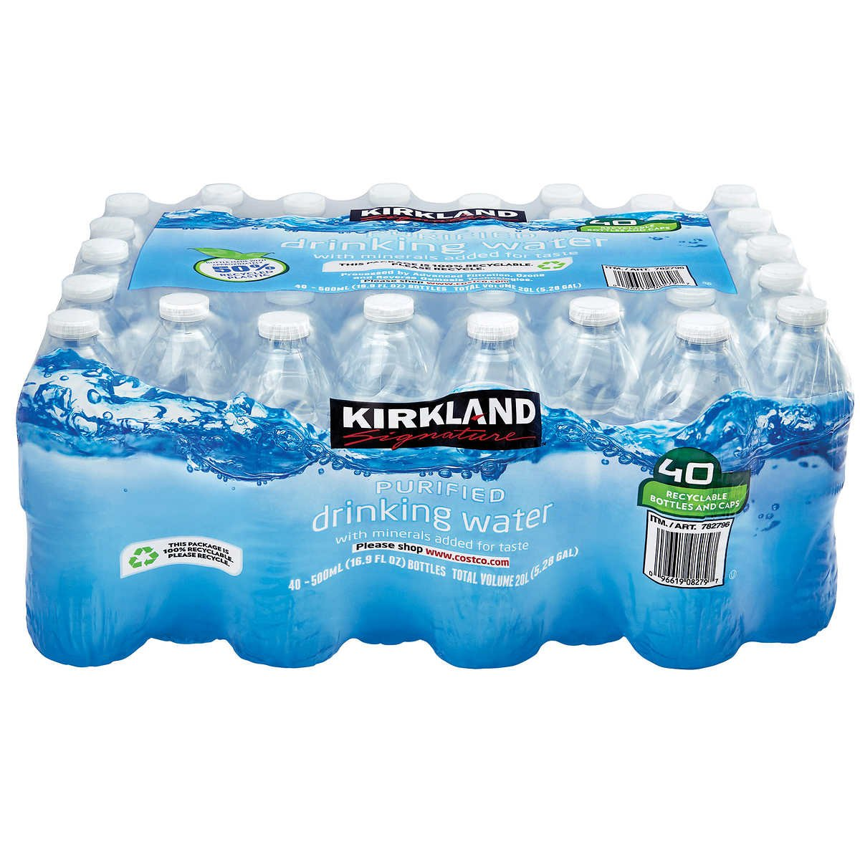
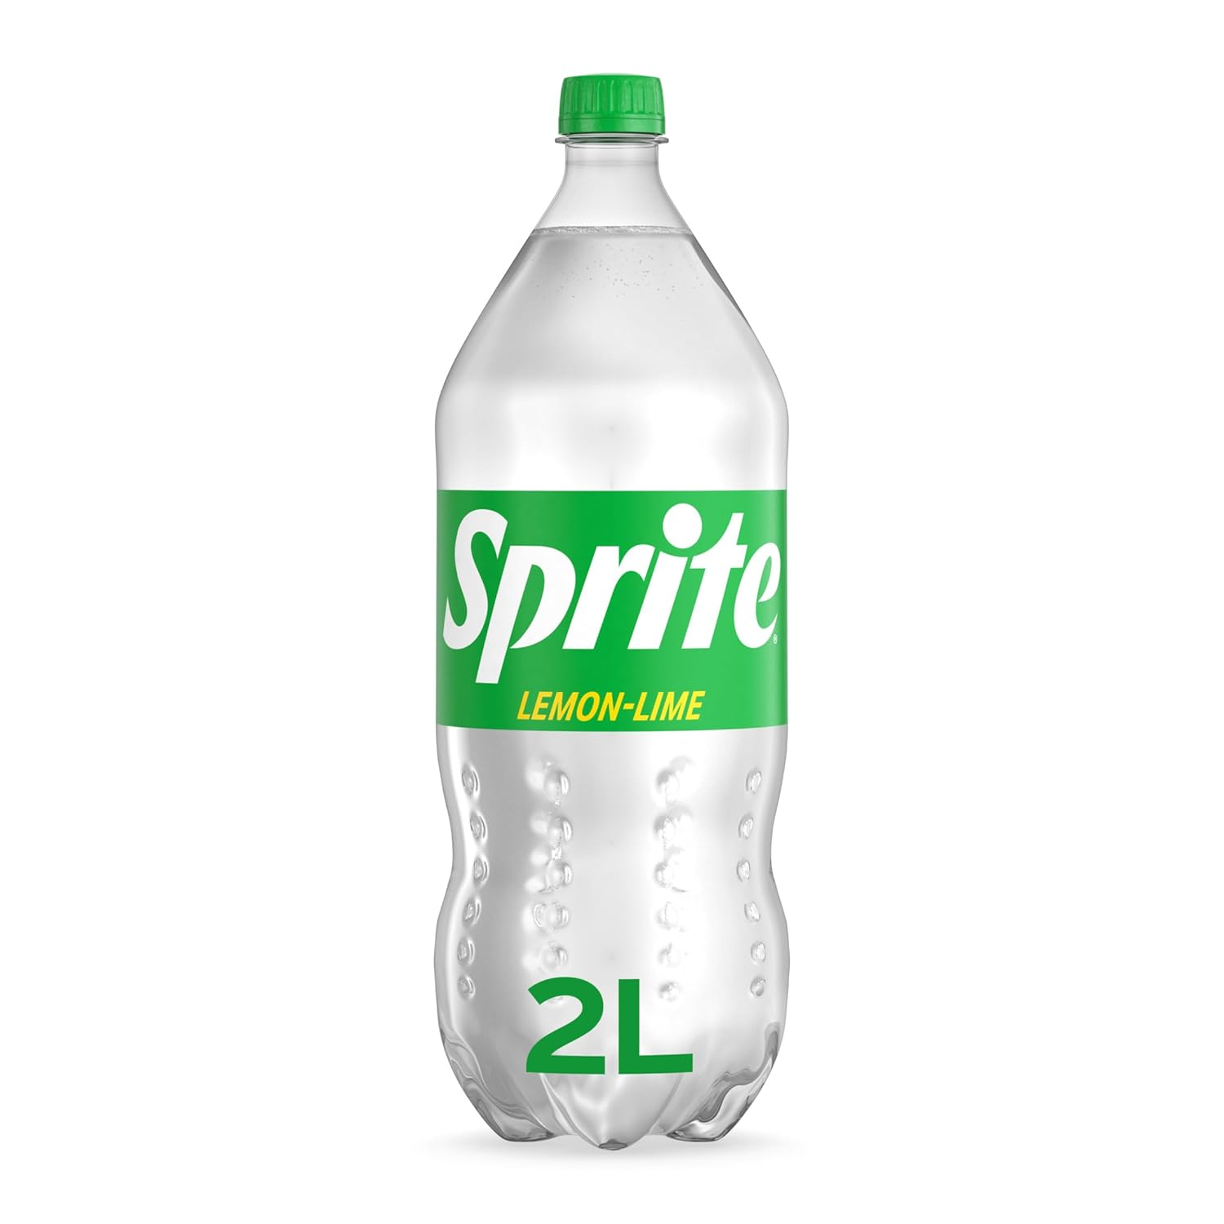
Drinking water
1 gal per per person per day
Hygiene and cooking 1 gal per person per day. 2 weeks is 28 gal per per person

Slide 19
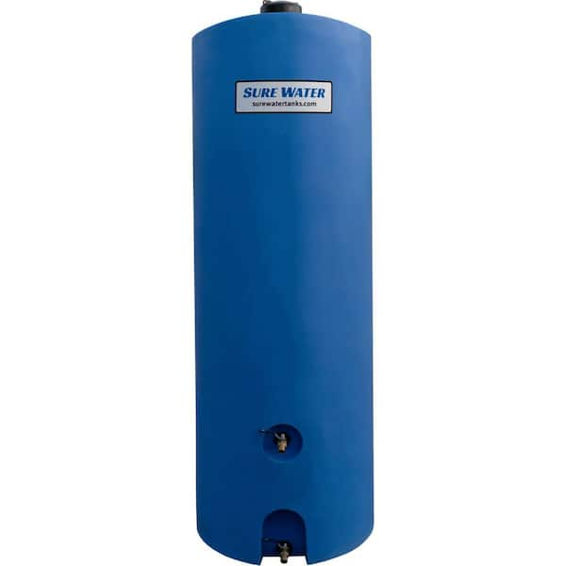
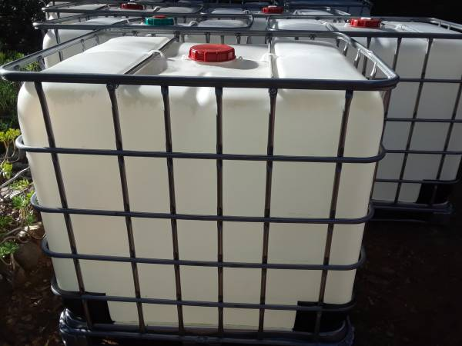
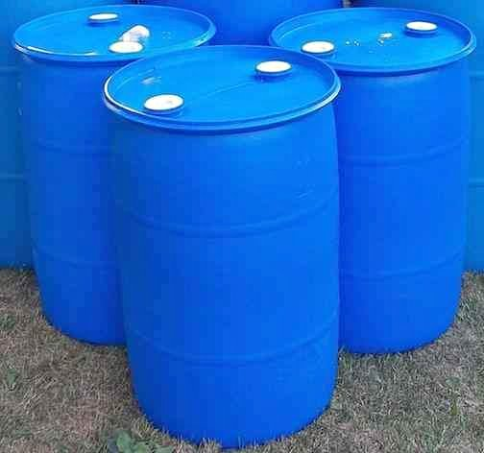
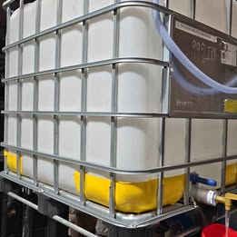

Slide 20
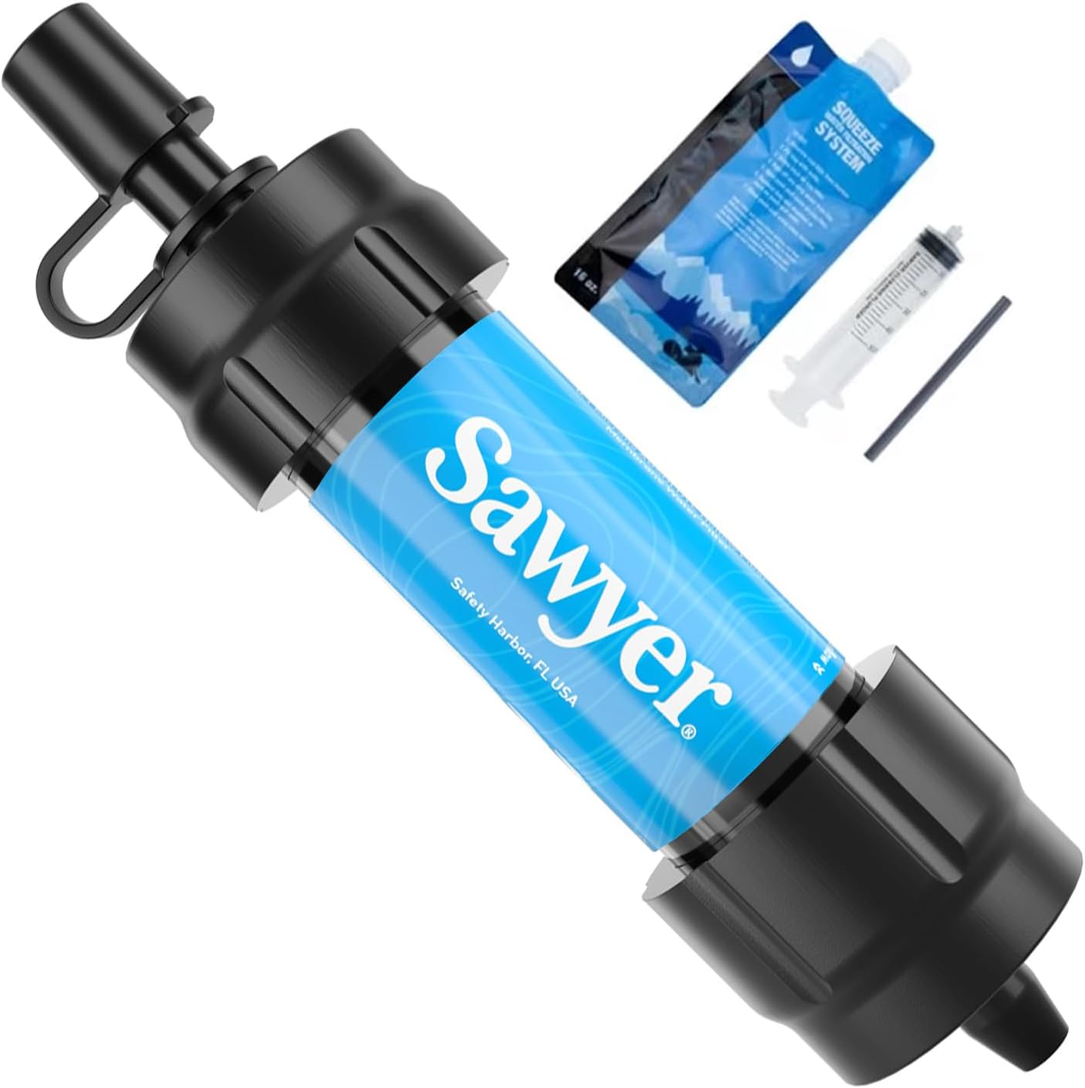
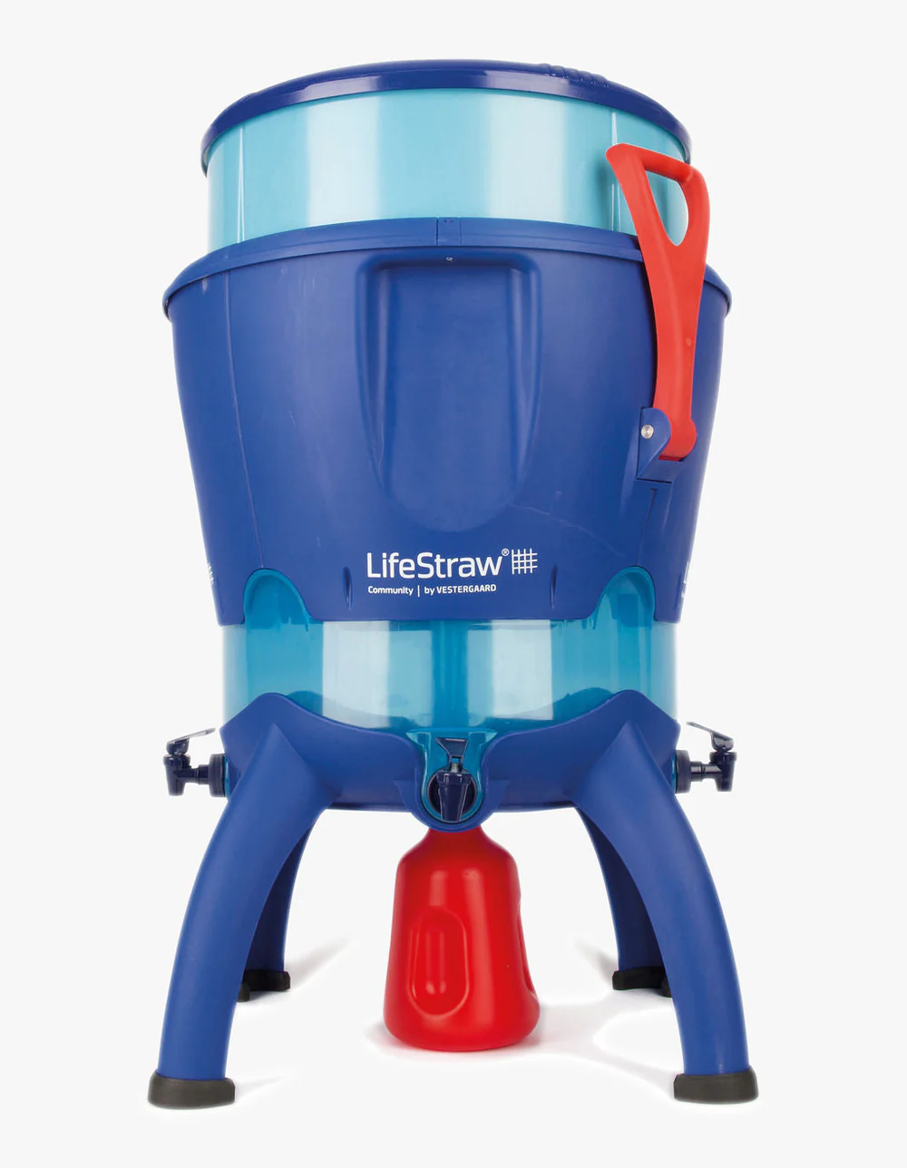
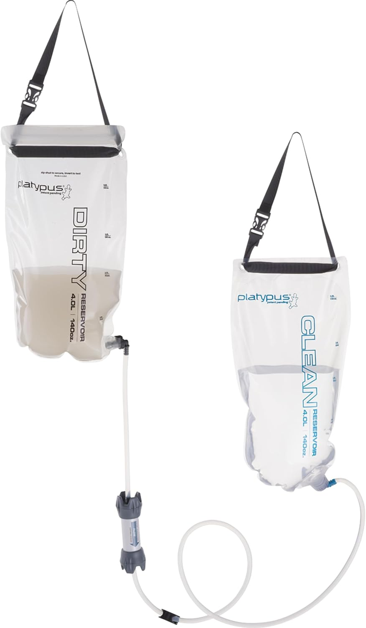
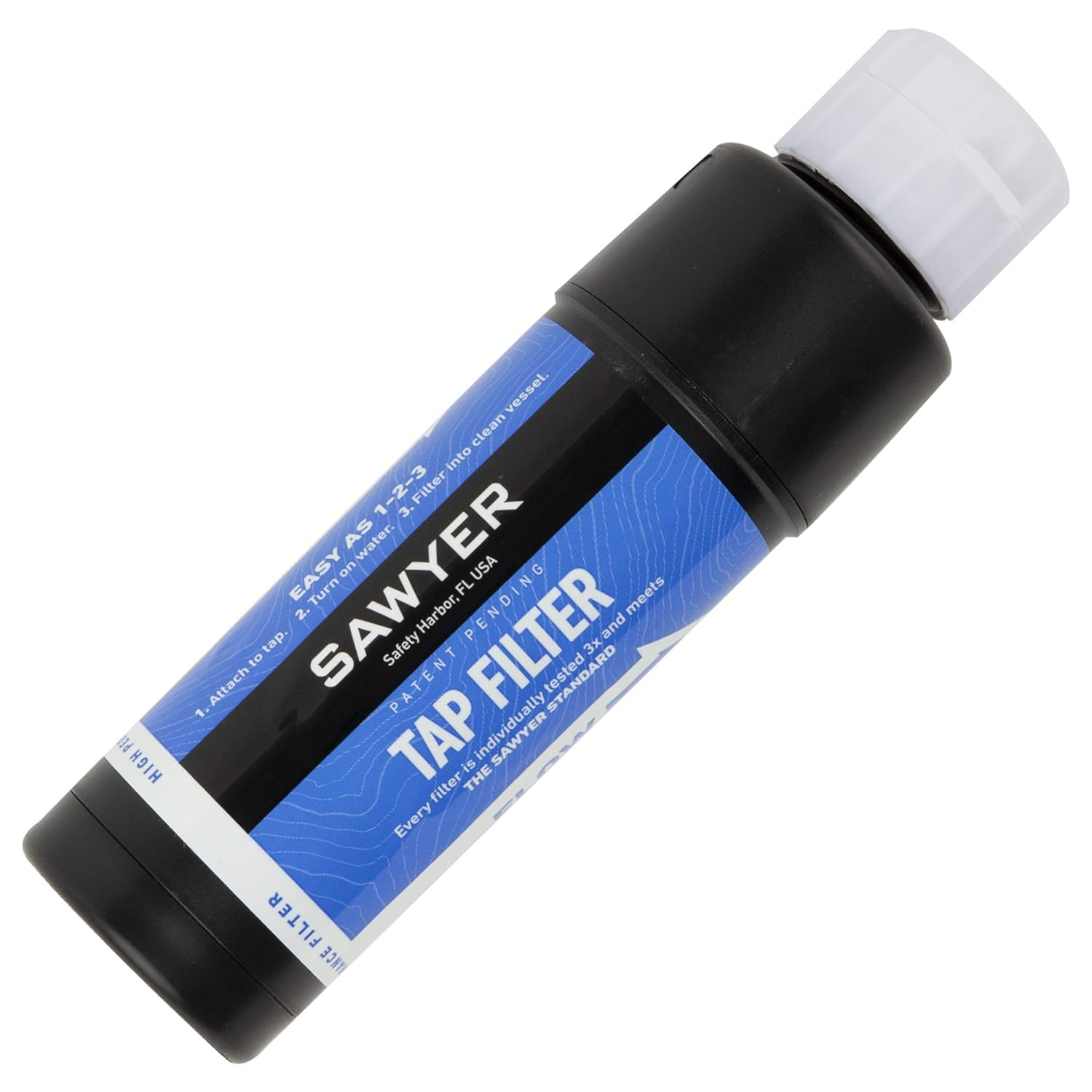
Filtering water

Slide 21
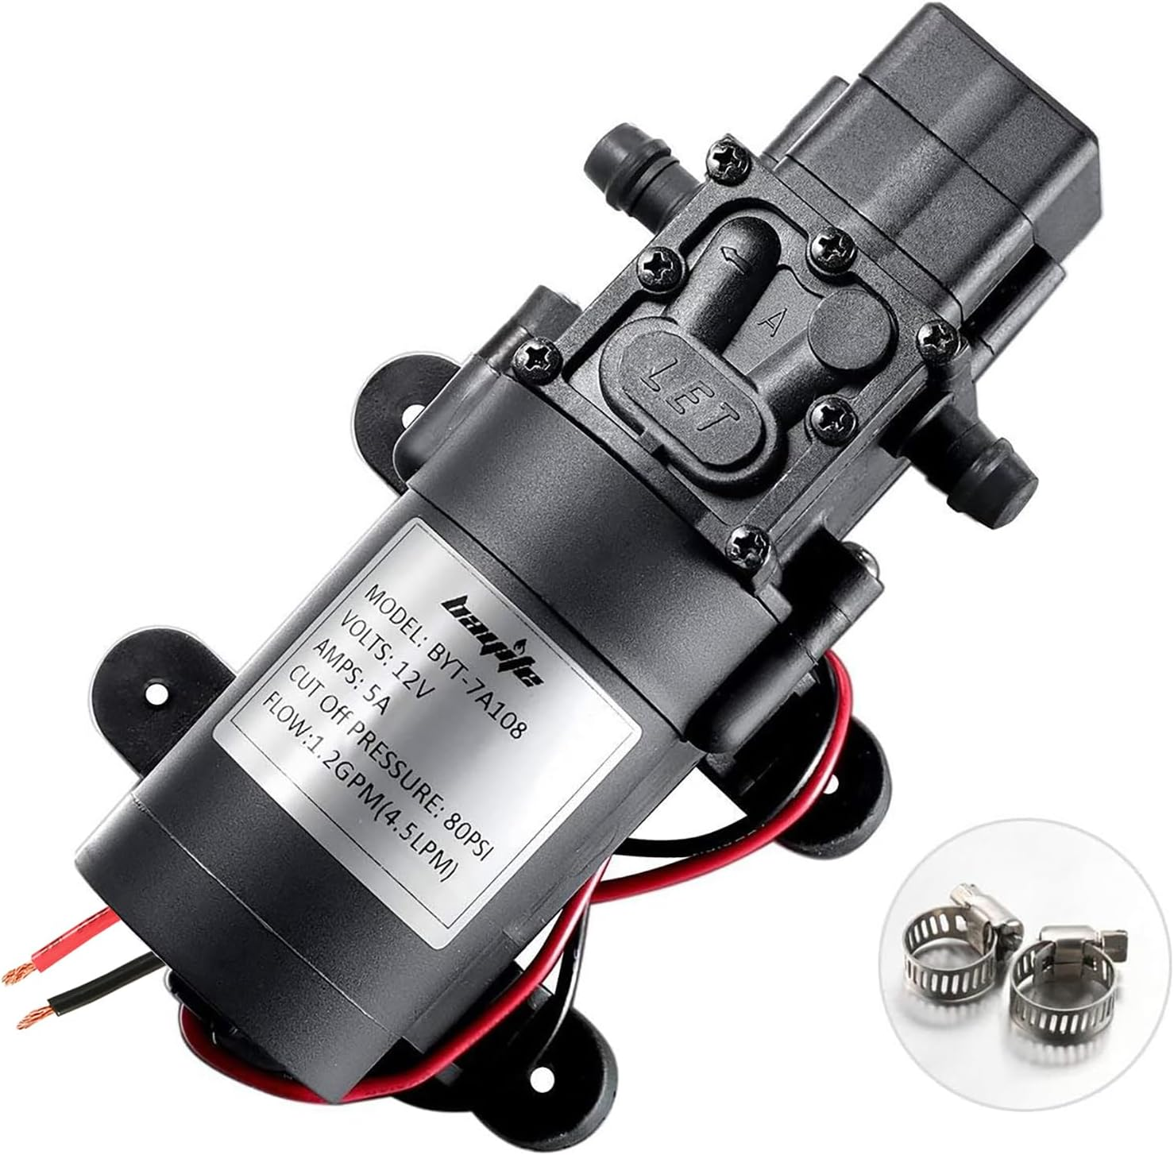
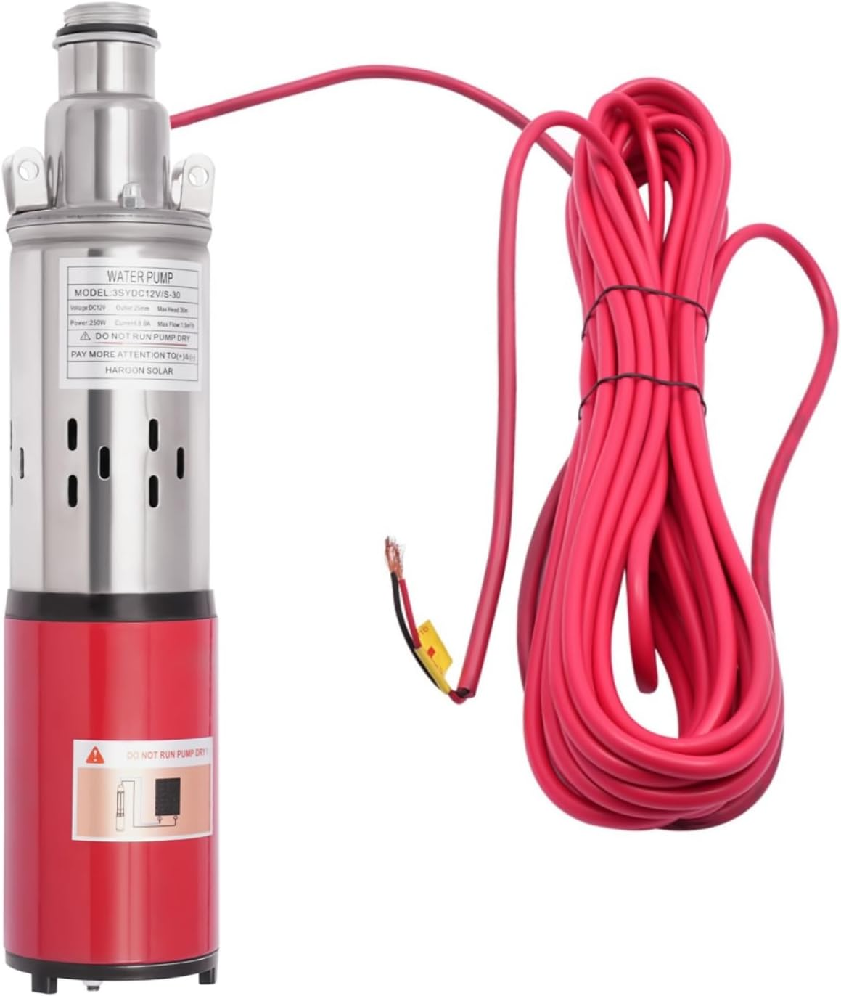
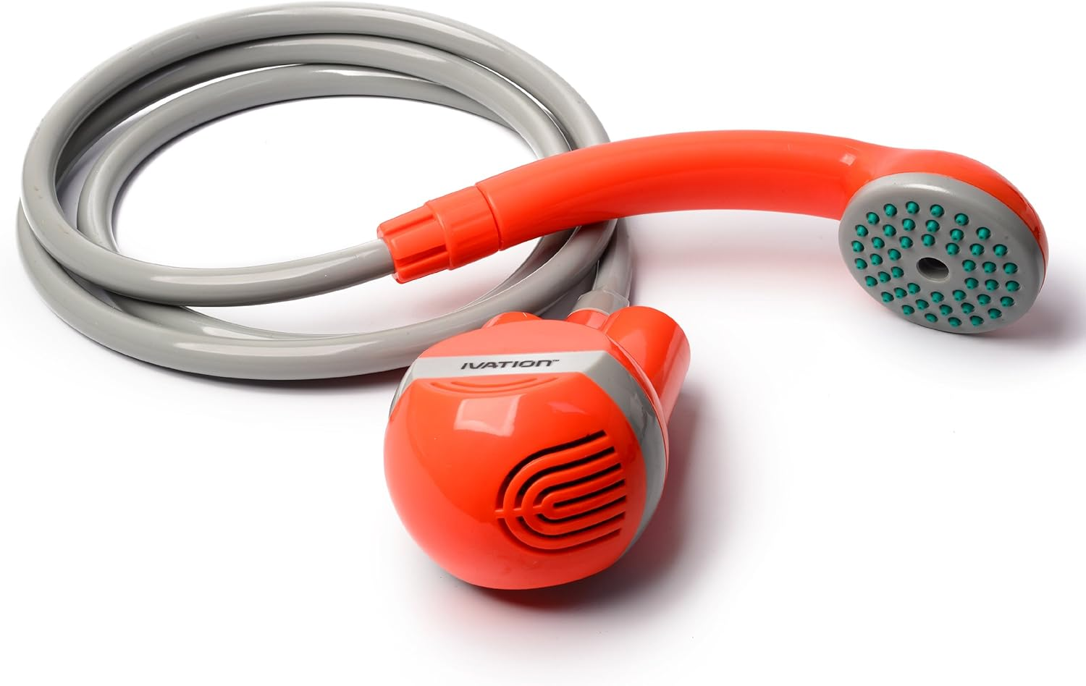
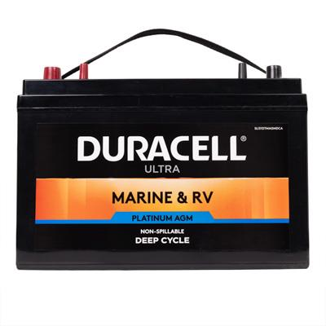
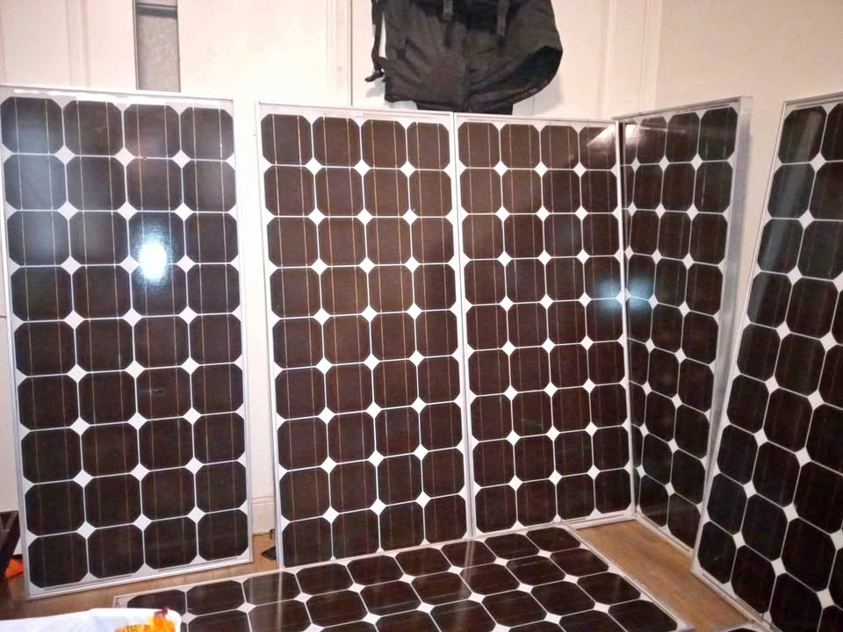
Battery and solar pumps

Slide 22
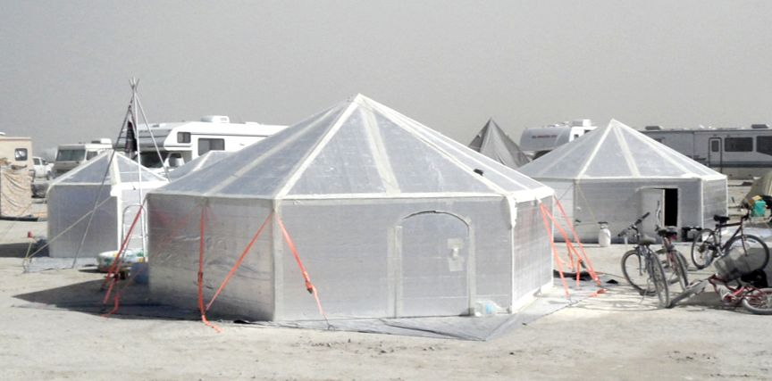
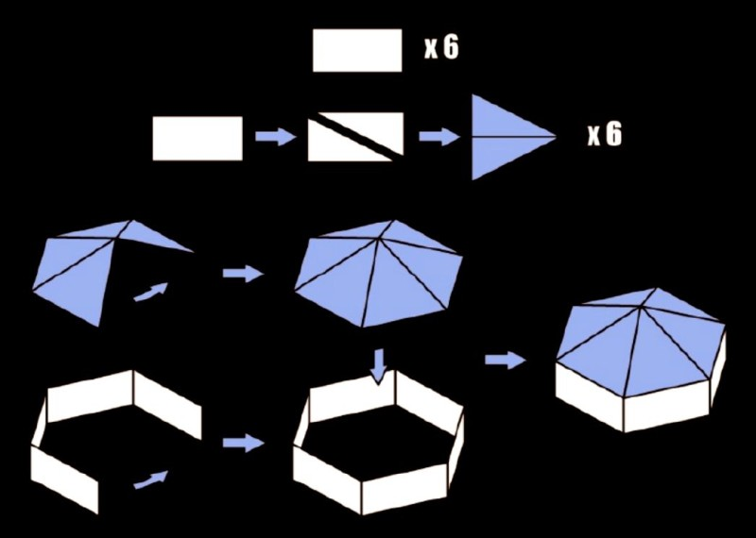
Location
Basement, Shade tree or shady porch, Store across town with power
Use block out curtains, Rooms with cross breeze, rechargeable fans
Stay out of full sun, work or exercise in the early morning
Shade canopy
Hexayurt
Shift pod or ice fishing tent-

Slide 23
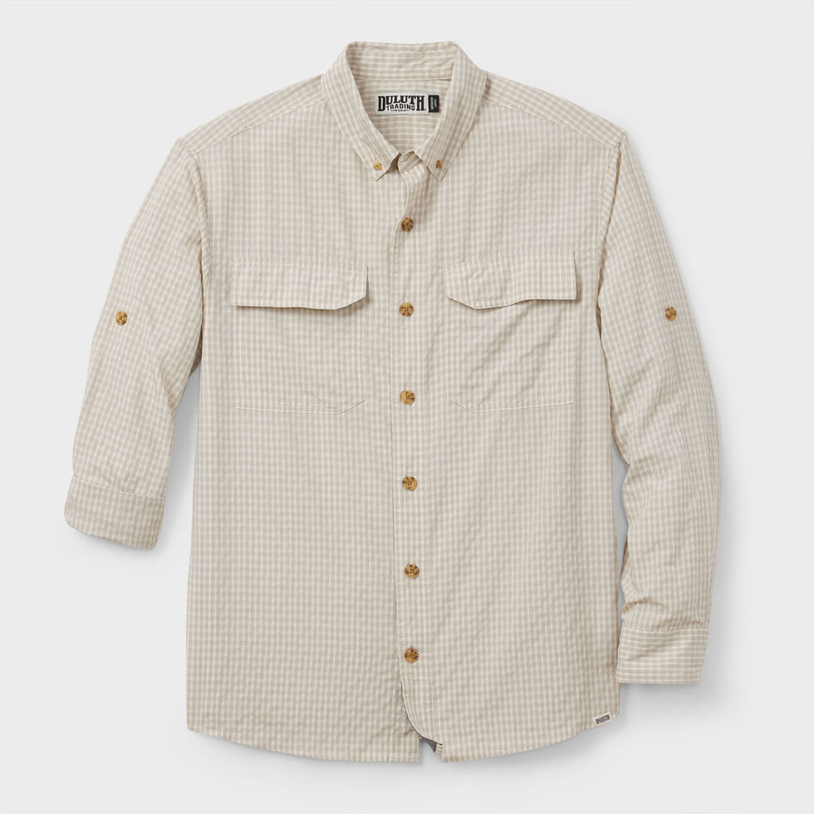
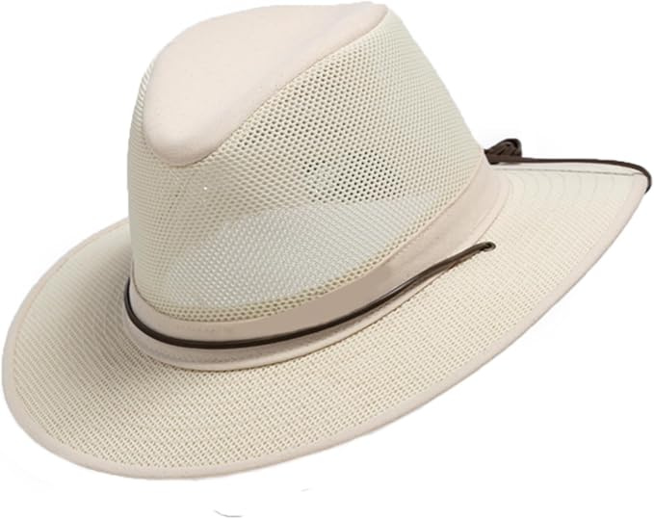
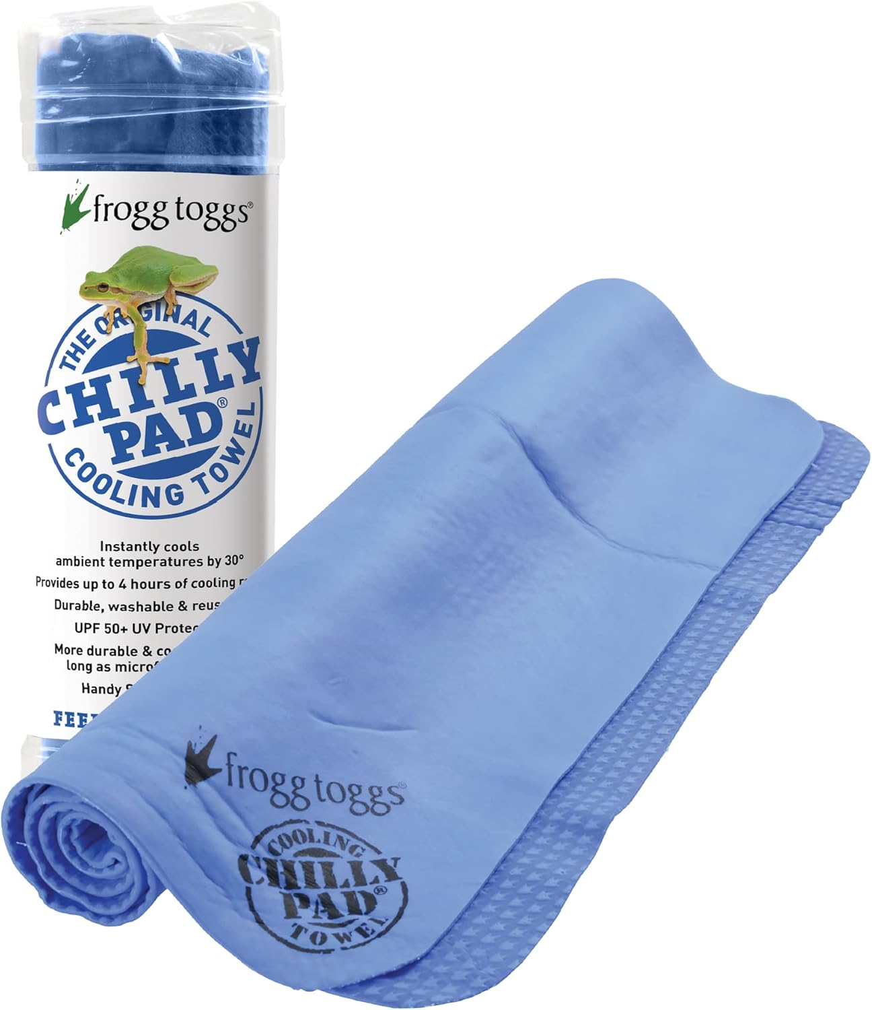
Clothing
Natural light colored loose fabrics (Loose woven cotton and linen)
Wicking fabrics UV protection (Armachillo, fishing shirts, light cotton skirt)
Hats with wide brims and ventilation
Cooling towel and bandanas
Mideastern, Bedouin inspired dress… flowing protection from the heat (keeping extreme heat out)
Umbrella

Slide 24
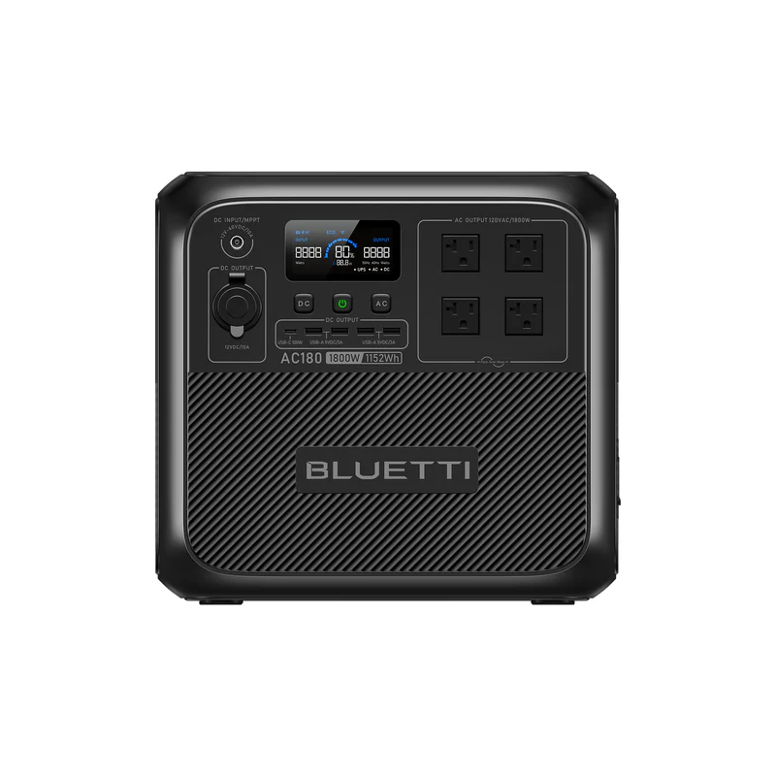
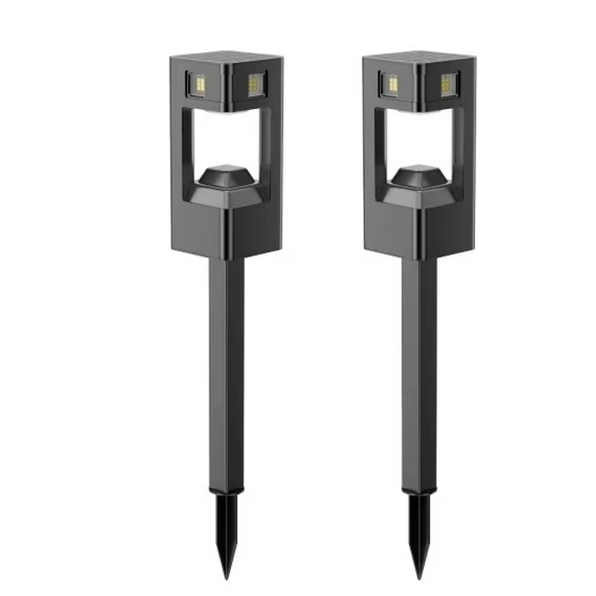
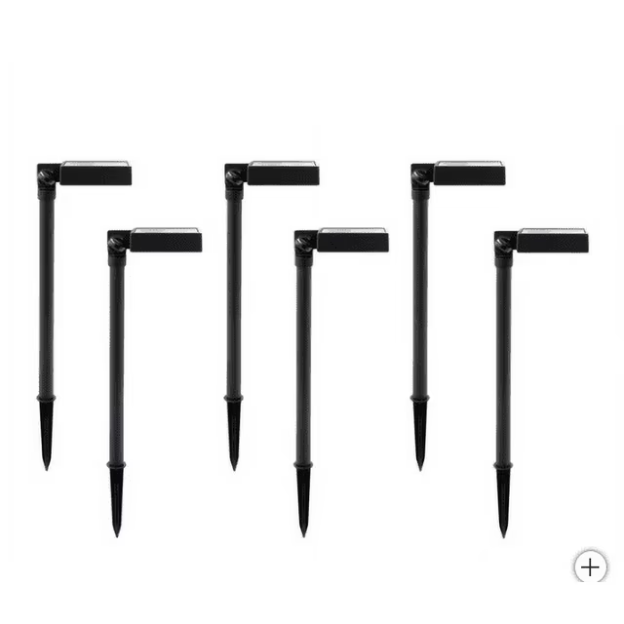
Battery power
Bluetti, Ecoflow, Jackery, Goal Zero, Anker
Solar panels
Inverters
Watt hrs
Amp hrs
Infinity Pathway 50 lumen CREE SMD LED Security Path Light, 2-pack
Tommy Bahama Solar LED Down Light, Adjustable Head, 40 Lumen, 6-pack

Slide 25
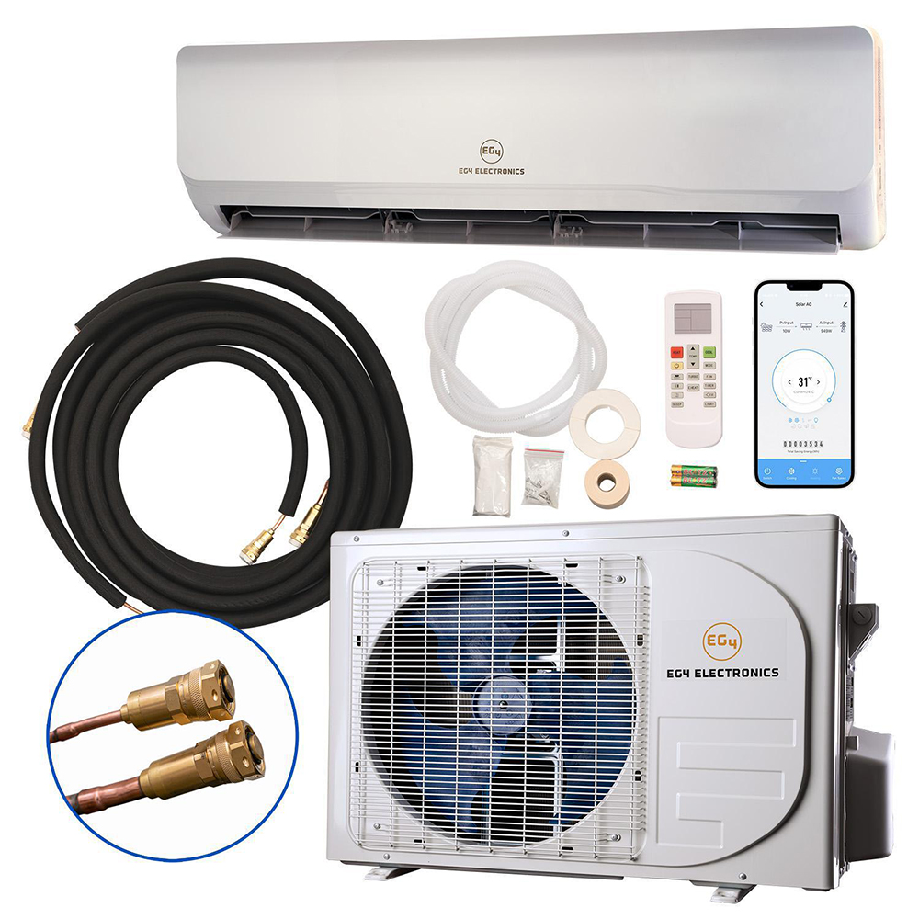
Fans and air conditioners
Neck fans
Battery fans
Misting fans
Cooling fans
Mini split air conditioner EG 4 solar
4in1 compressor air conditioners
Portable swamp coolers
DIY swamp cooler

Slide 26
What not to eat when it’s hot:
Avoid caffeine, hot drinks, hot foods
Avoid very spicy hot foods
Avoid Cooking in the oven or stove (cook outside or early morning)
Avoid heavy calorie rich foods (meat, potatoes, pastas)
A calorie is a unit of measure of energy. Very specifically, it is the amount of energy that is required to raise the temperature of one mL, (which is also one gram), of water by one degree Celsius. The word calorie was actually coined by the great French chemist Antoine Lavoisier who used it to refer to the body’s internal heat.

Slide 27
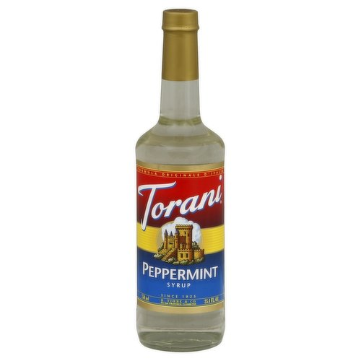
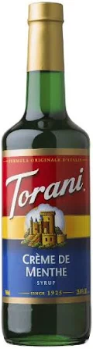
What to eat
Lot and lots of cool water
Fresh fruits and vegetables (lettuce, celery, peas )
Fruit juices (coconut water, aloe juice)
Mint (peppermint oil, Torani mint)
Shave ice
Wintergreen lifesavers
Sports drinks and electrolyte supplements
Salty foods and snacks
More water

Slide 28
Build Zion
Internally - Repent, Forsake, Humble, Pray, Study, Act in Faith,
Covenant
Externally- Share, Love, Forgive, Sacrifice,
Follow Him
If Ye are prepared Ye shall not fear

